Slide 1
Memory Game \(^-^)/ (Programming Class 06/03/2020)
- Lilas Guan

Slide 2

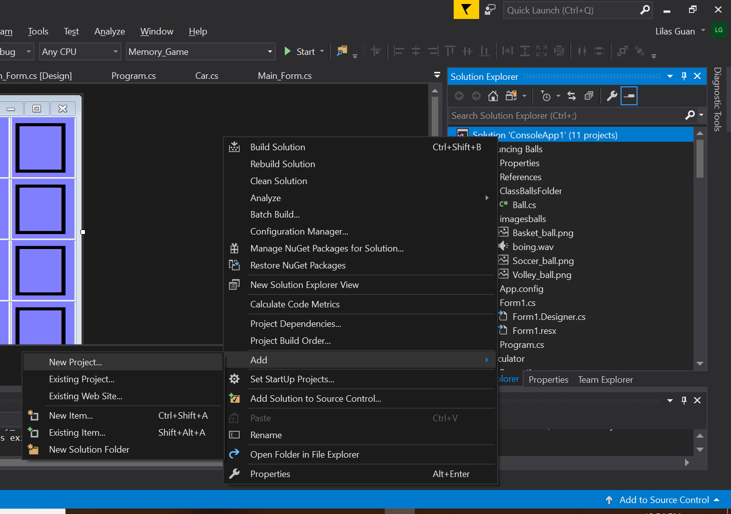
Let’s start by creating the layout
1. Let’s start by creating a new project :D

Slide 3
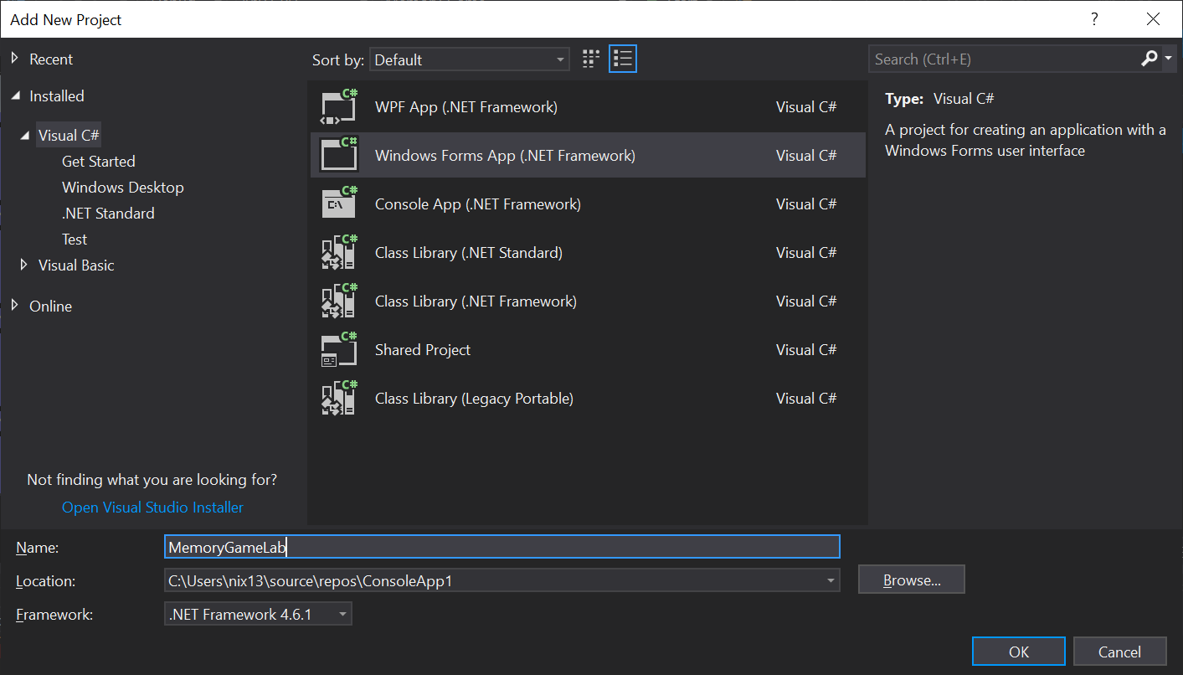
Let’s start by creating the layout
2. Choose Windows Forms App (.Net Framework) Visual C#
and name your project (^^)
Then click “Ok”

Slide 4
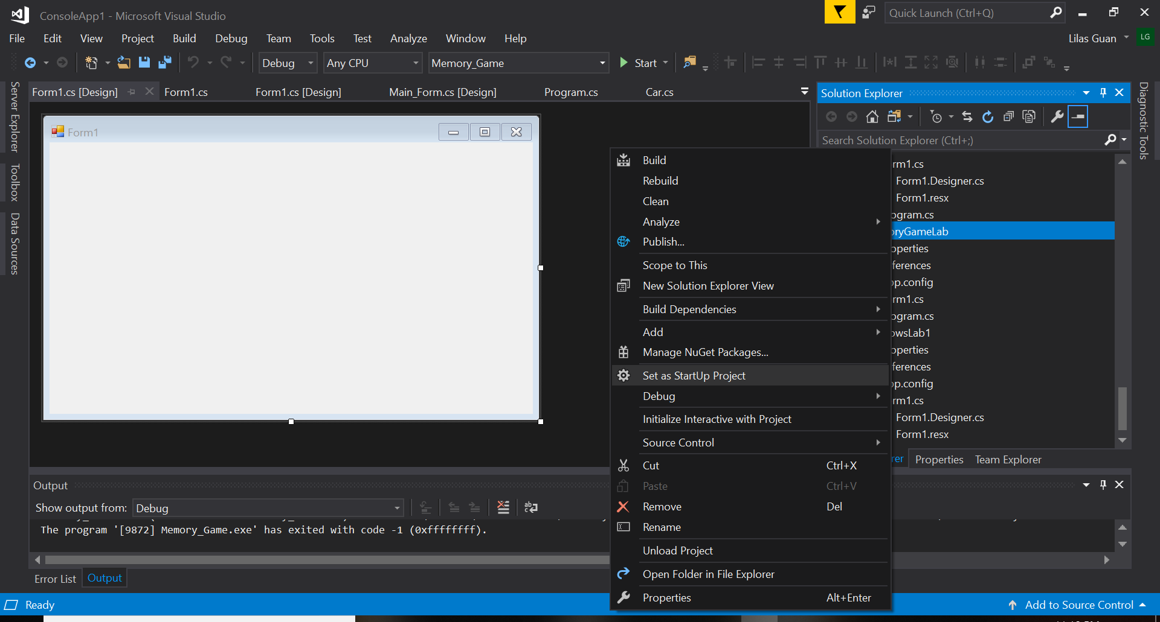
Let’s start by creating the layout
3. Set your new project as StartUp Project :o

Slide 5
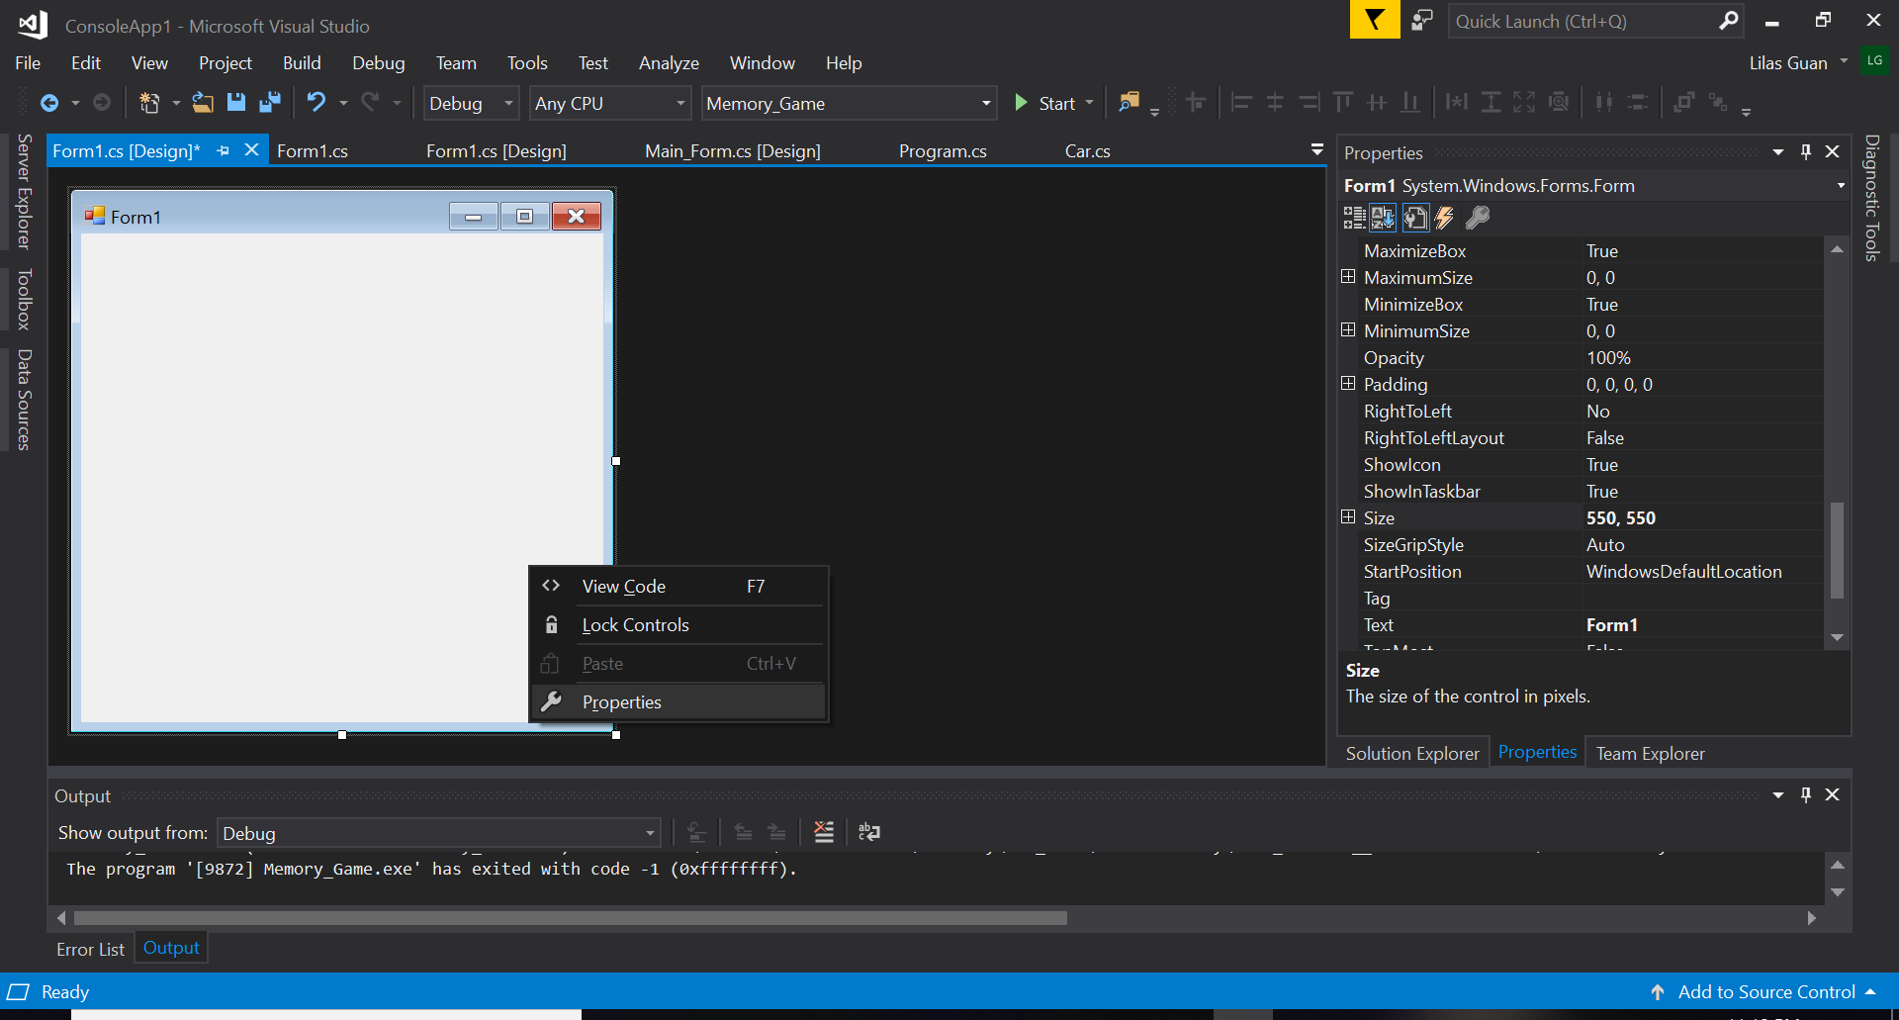
Let’s start by creating the layout
4. Now the real thing start oxo”
a. Right Click on your Form1 and click Properties
b. In Properties, Find “Size” and change the values to “550, 550”

Slide 6

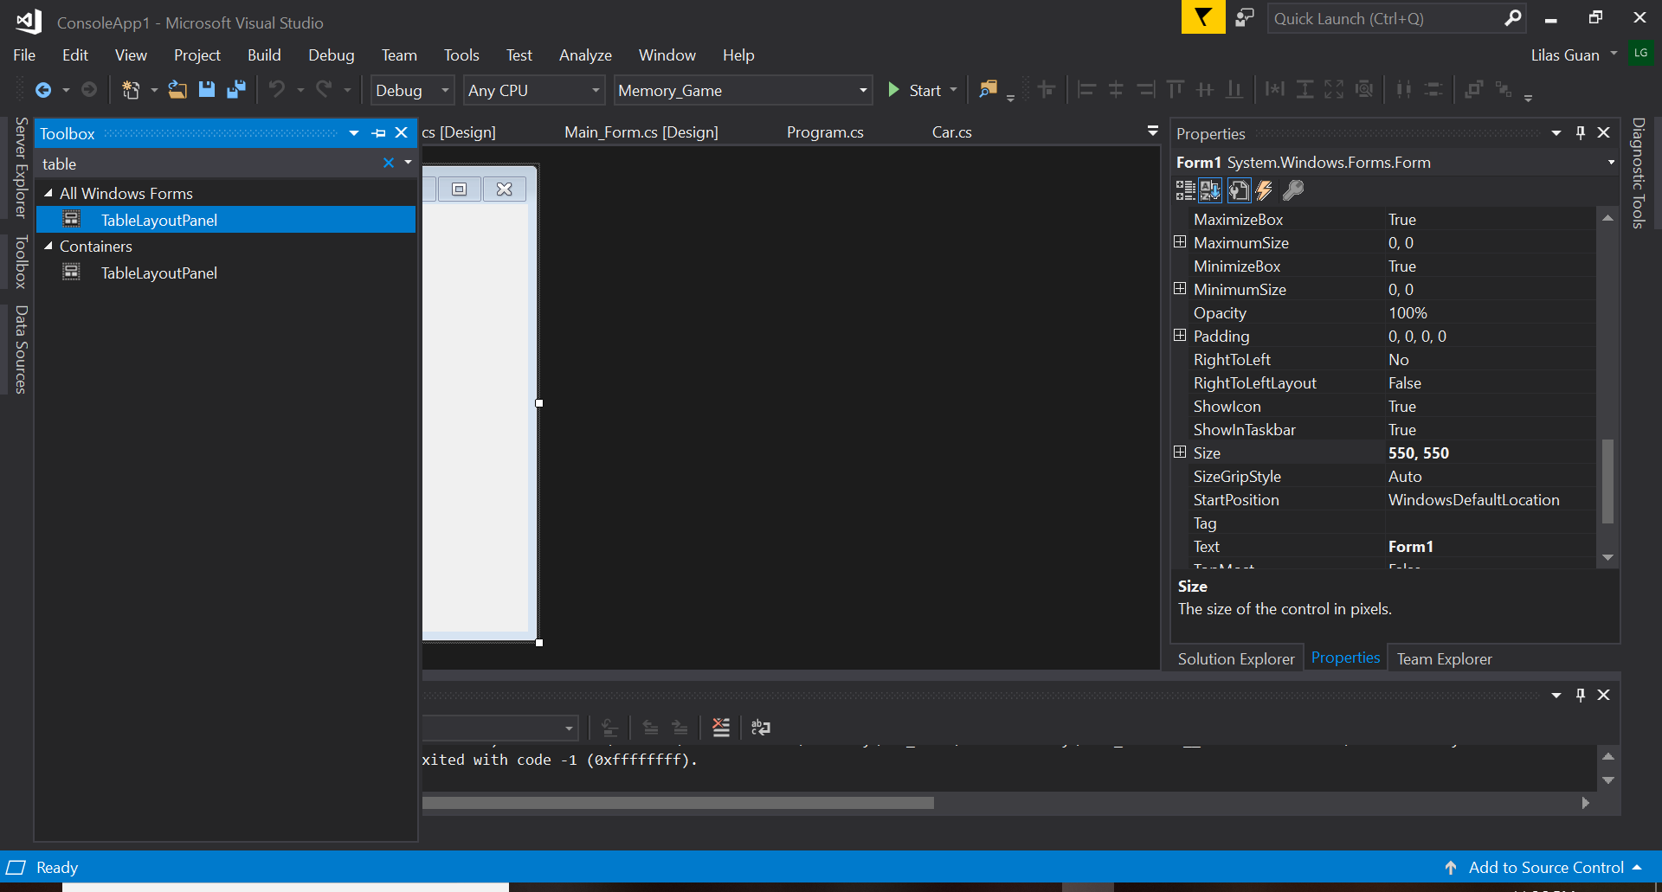
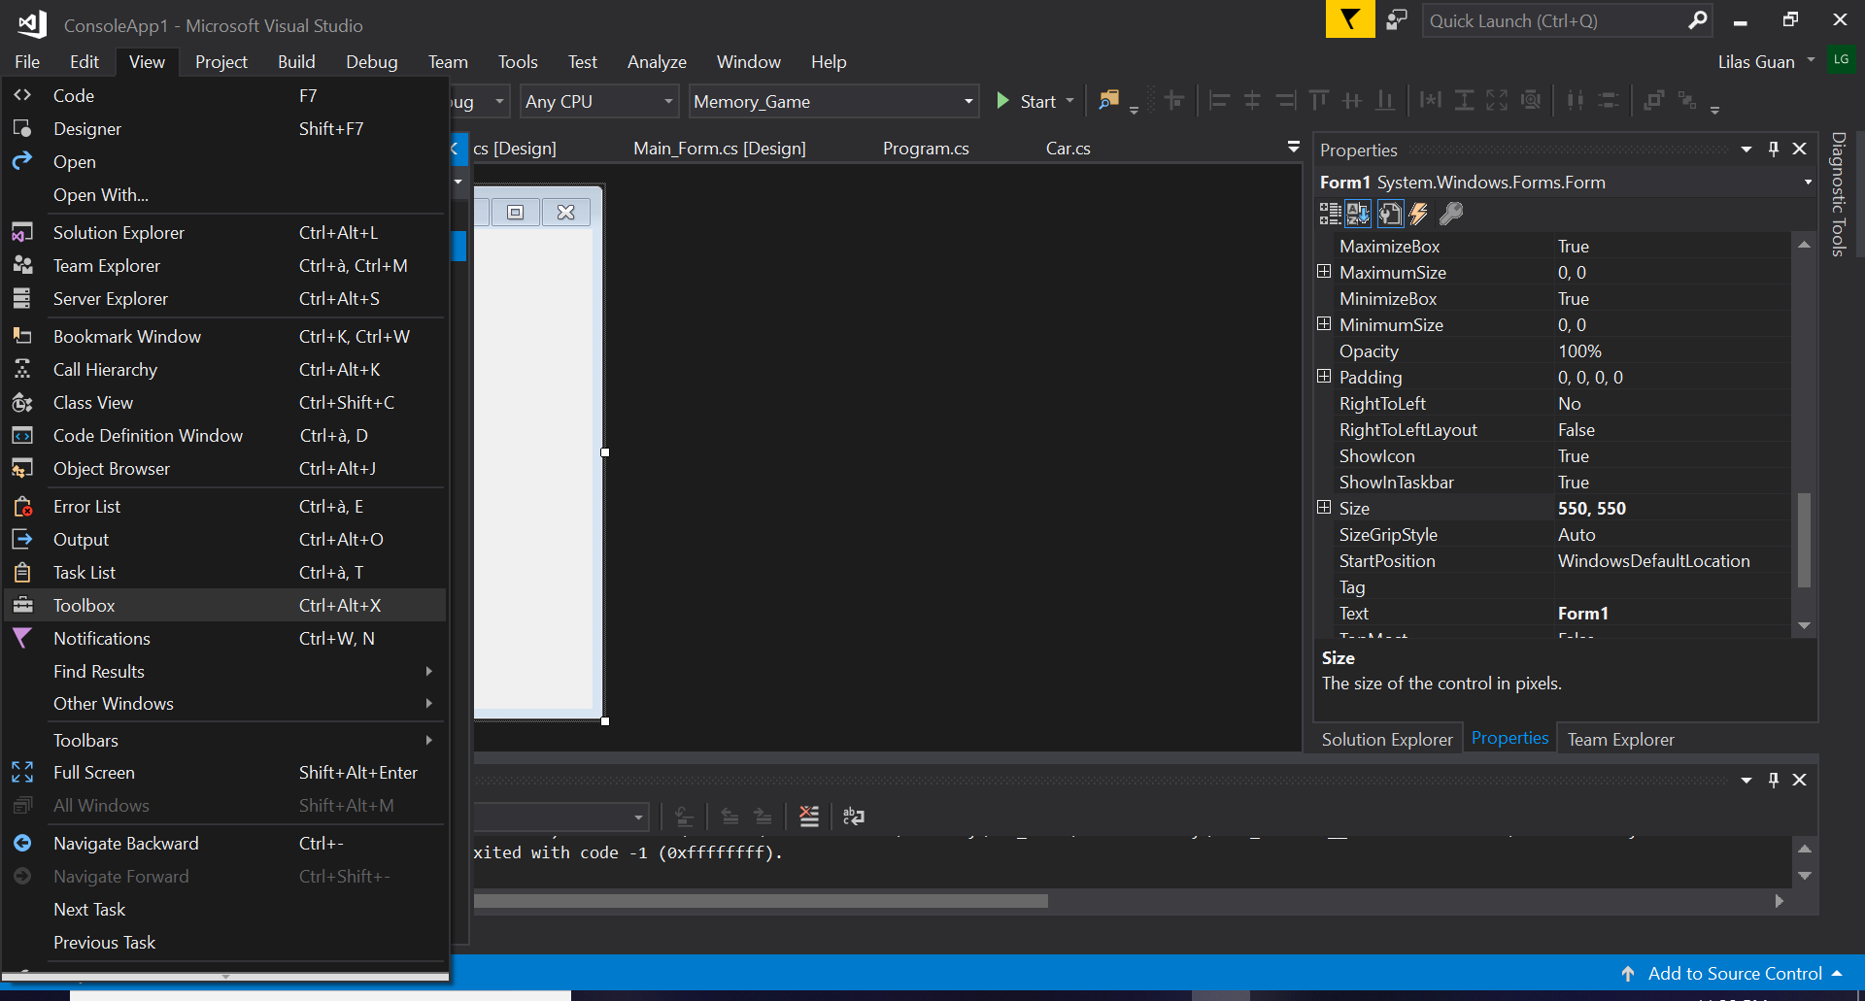
Let’s start by creating the layout
5. Starting the Layout of the game :,)
a. Go to “Toolbox” and find “TableLayoutPanel”
b. Click on “TableLayoutPanel” and Click anywhere on “Form1”

Slide 7
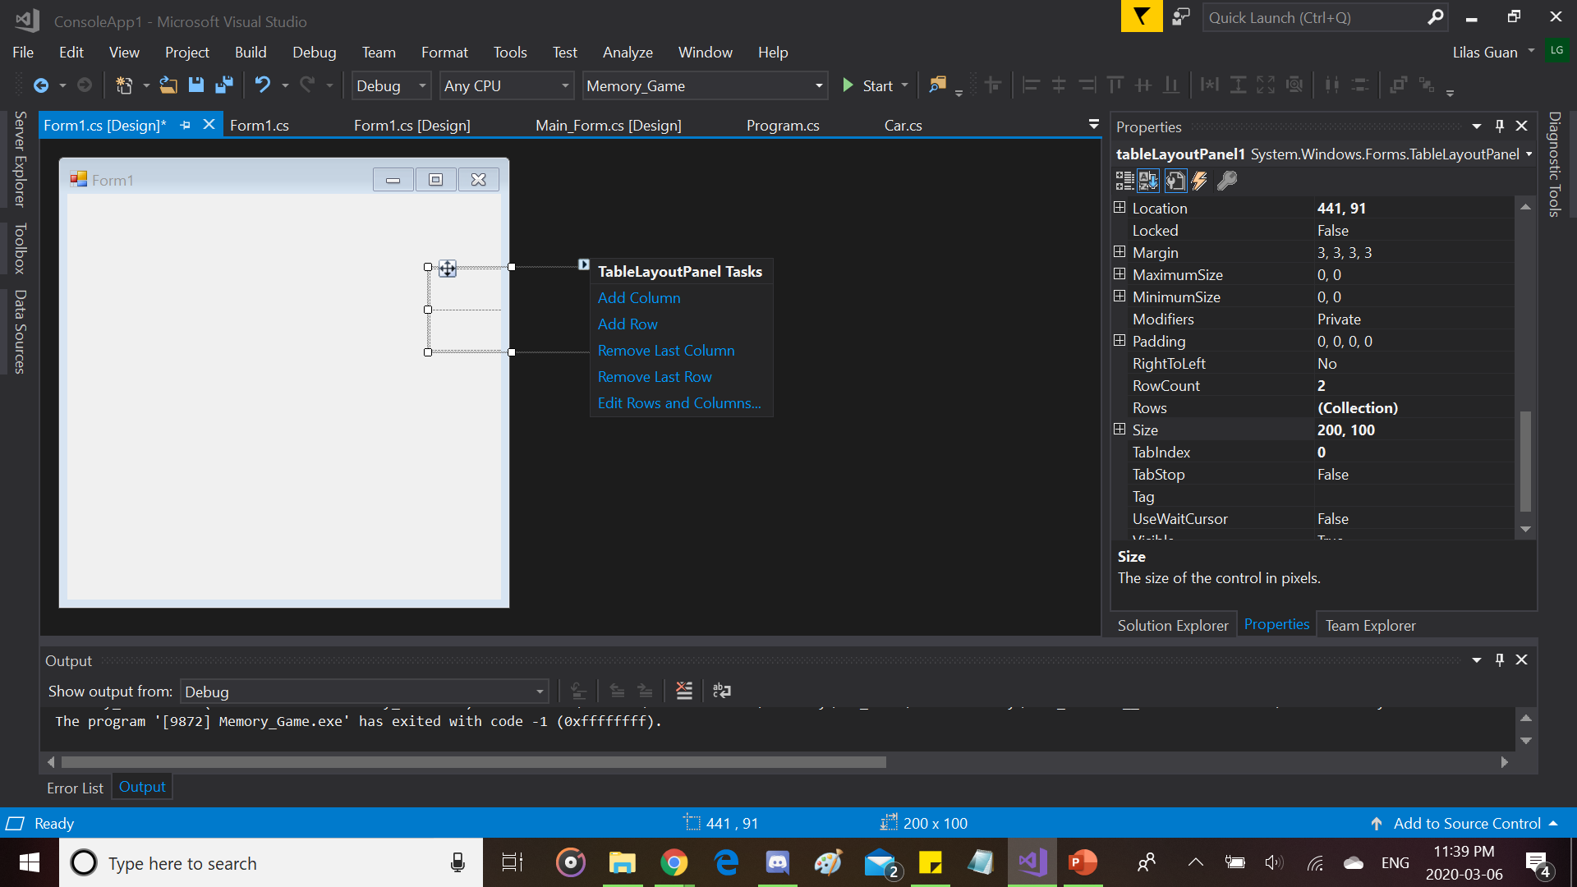
Let’s start by creating the layout
6. Well let’s get ready ;)
a. Once you click on “Form1” with
“TablePanelLayout”, that’s what you get oxo
b. Now click on “Edit Rows and Columns…”

Slide 8
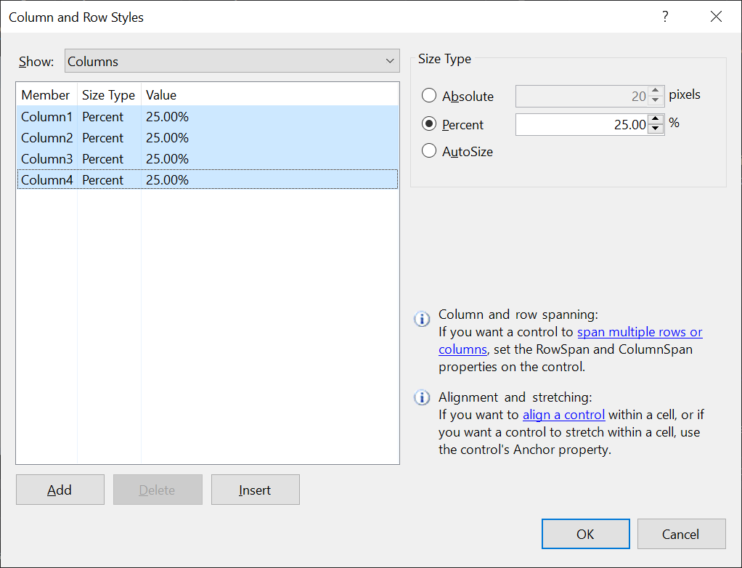

Let’s start by creating the layout
7. Watch and learn (Do the same thing for Rows and Columns) xD
a. Add two more Columns/Rows
b. Select all Columns/Rows
c. Click “Percent” and adjust the size to 25%
And just click “Ok”

Slide 9
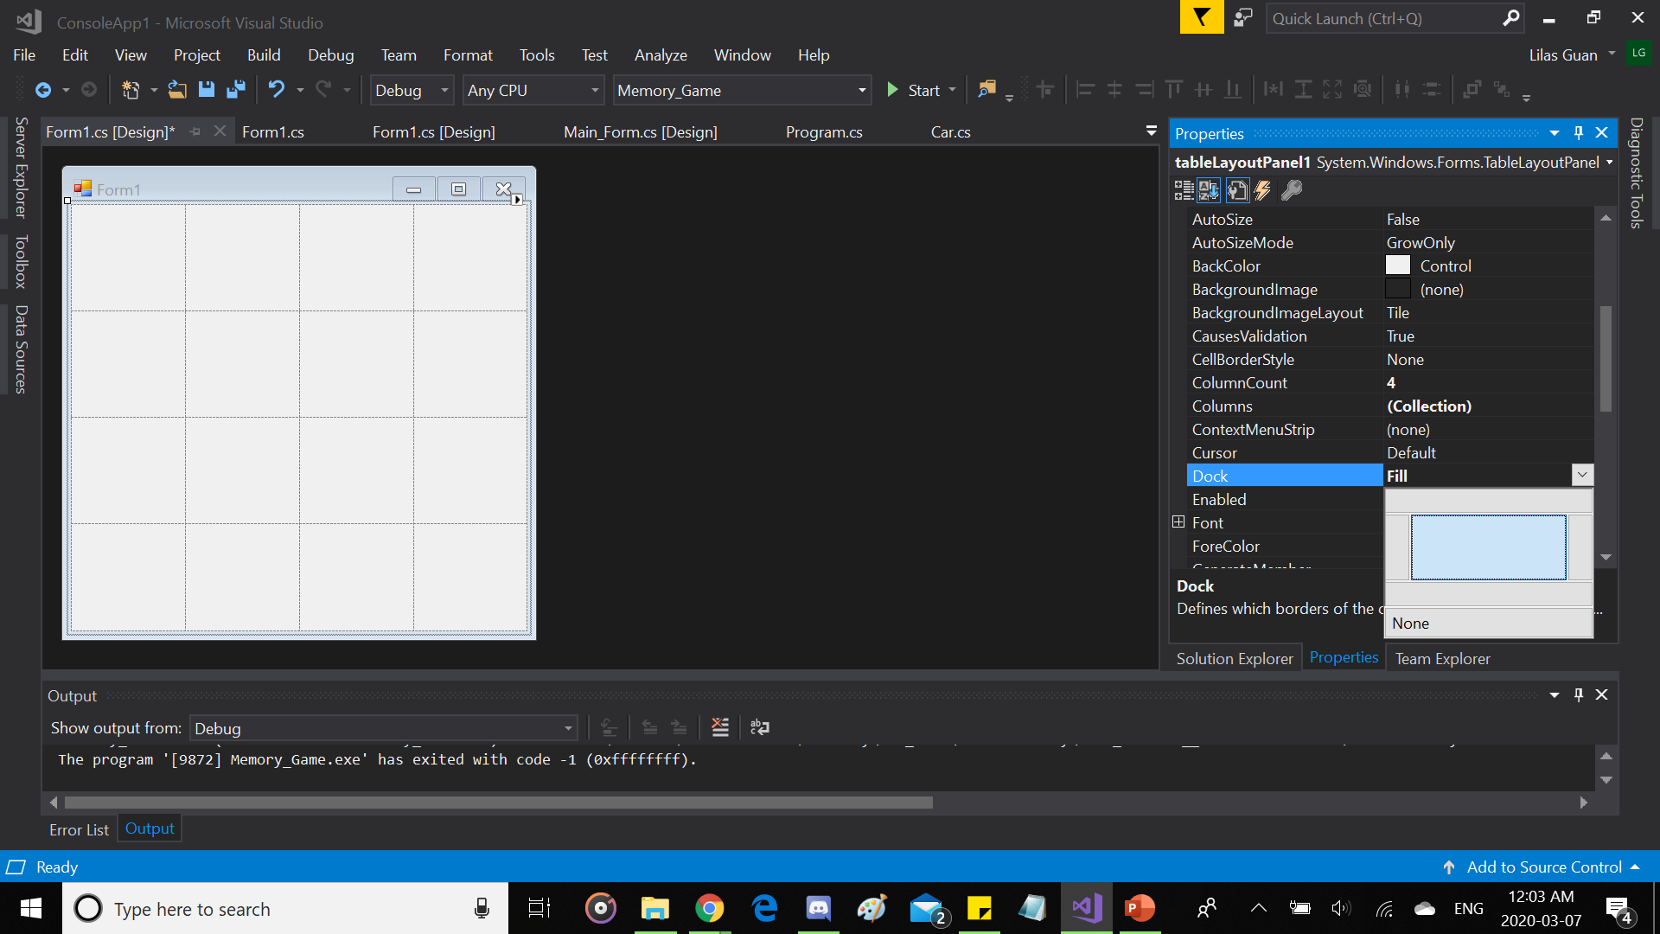
Let’s start by creating the layout
8. Well Blueprint complete @_@
a. Go to the Properties of our “tableLayoutPanel1”
and find “Dock” then click on the rectangle in the center
b. Result after “Dock” step looks like that

Slide 10
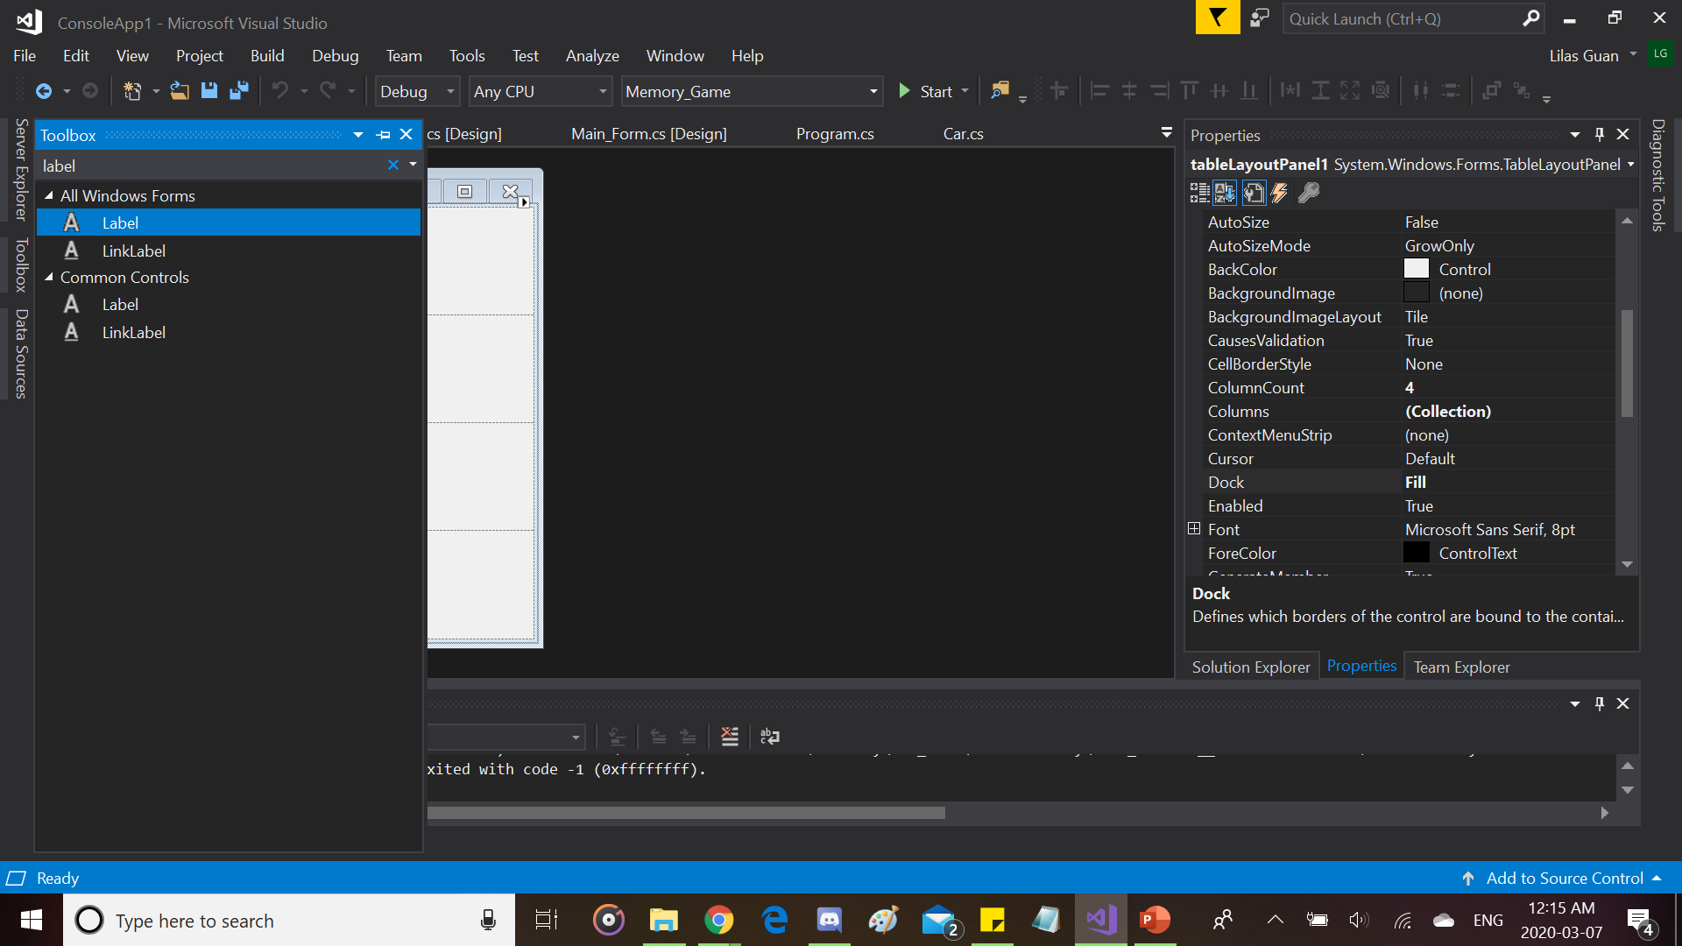
Let’s start by creating the layout
9. Building Process (^^;)
a. Go to “Toolbox” and find “Label”
b. Click on “Label” and Click on one of the squares from our “tableLayoutPanel1”

Slide 11
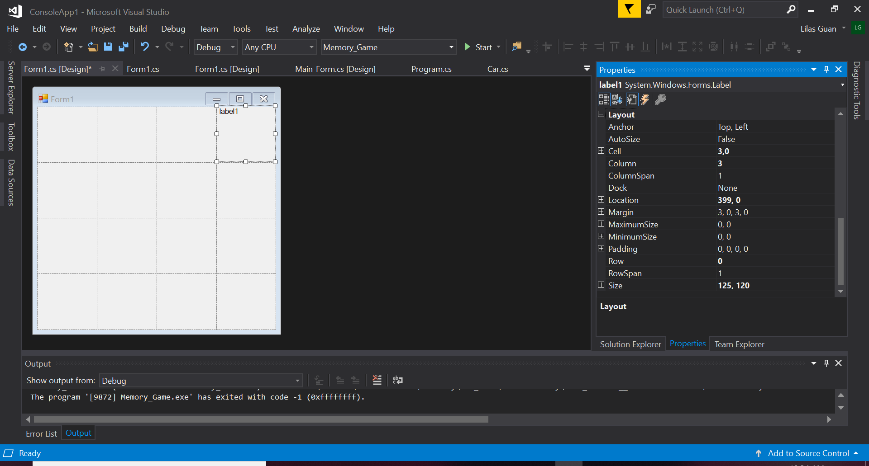
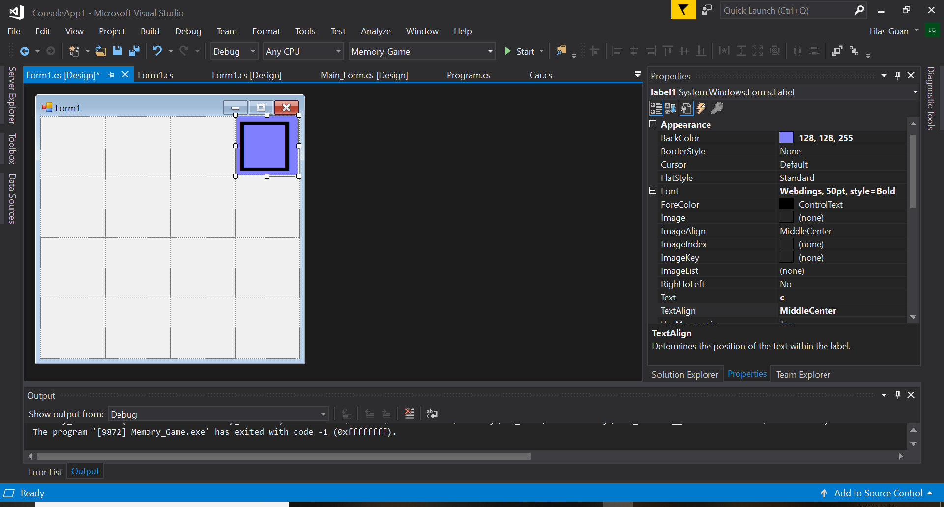
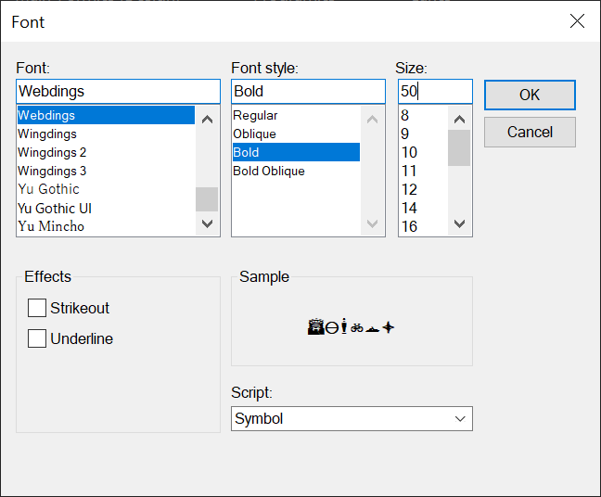
Let’s start by creating the layout
10. Details (-x-;)
a. In Properties of our “label1”, find “AutoSize” and change “True” to “False” (if not, you won’t be able to change the size of the label)
b. After that, find “Size” and change the values to “125, 120”
c. Then :
Find “BackColor” and choose a color
Find “Text” and type “c”
Find “TextAlign” and click the rectangle in the center
Find “Font” and change the current font to “Webdings” (to create icons from letters, numbers or special characters I guess), font style to “Bold” and the size to 50

Slide 12
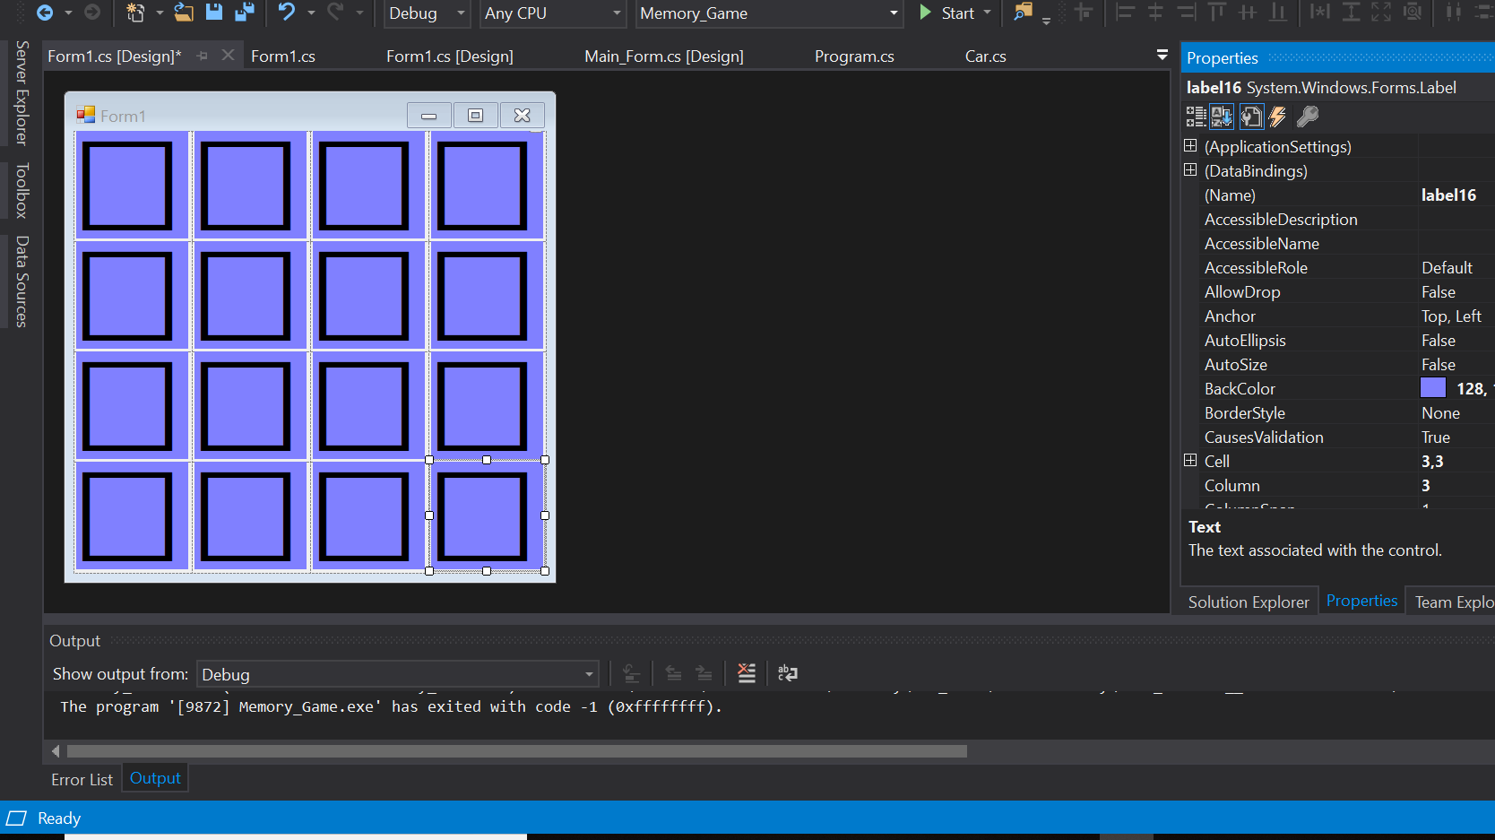
The Result should look like this !
Copy the label and paste it on each square of our “tableLayoutPanel1” oxo

Slide 13
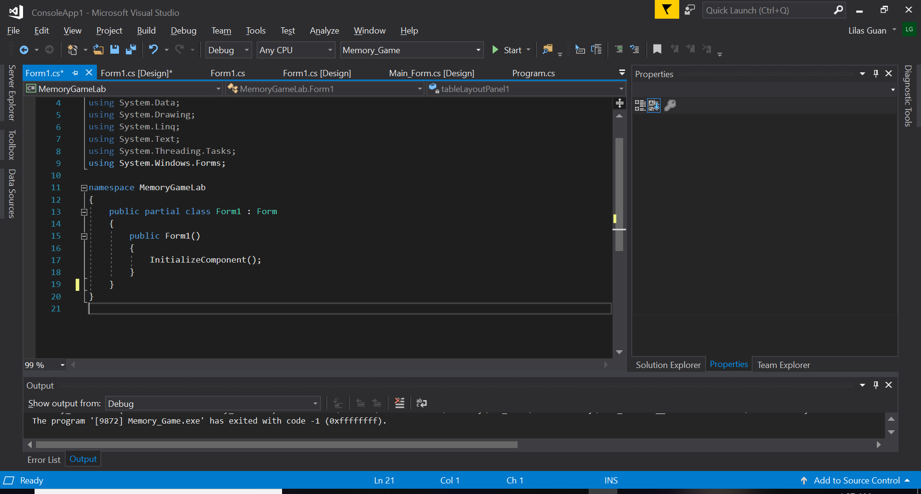
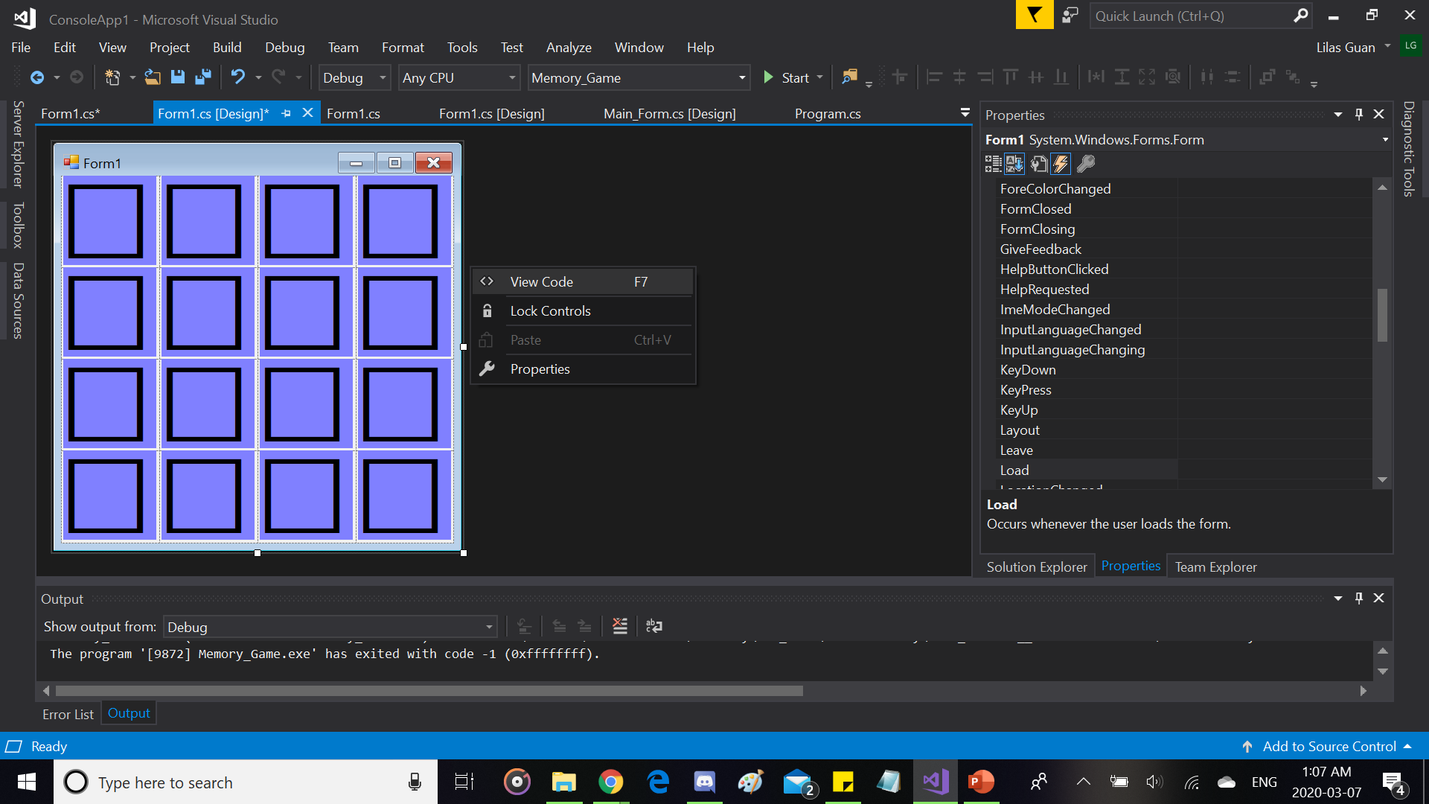
Now Serious Business, the code T-T
1. Click on “Form1”, Right Click it and click “View Code” :)

Slide 14
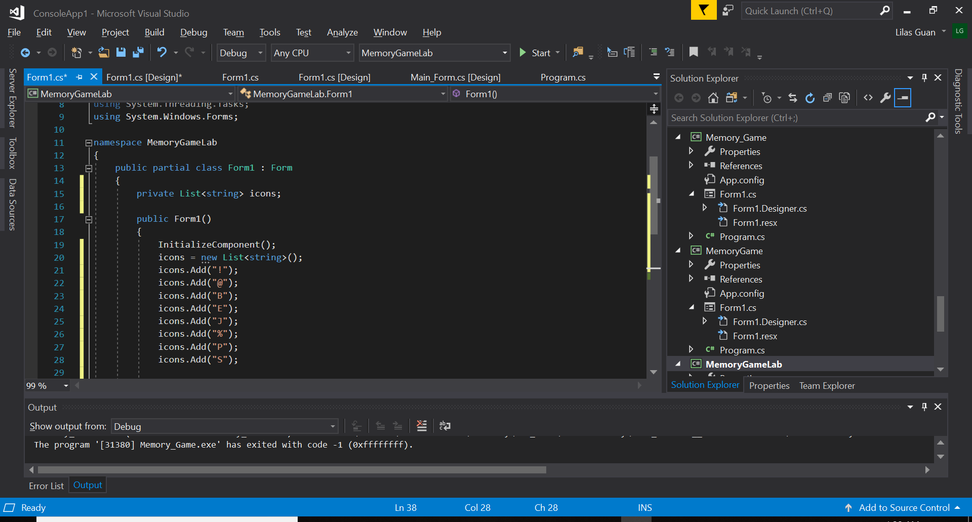
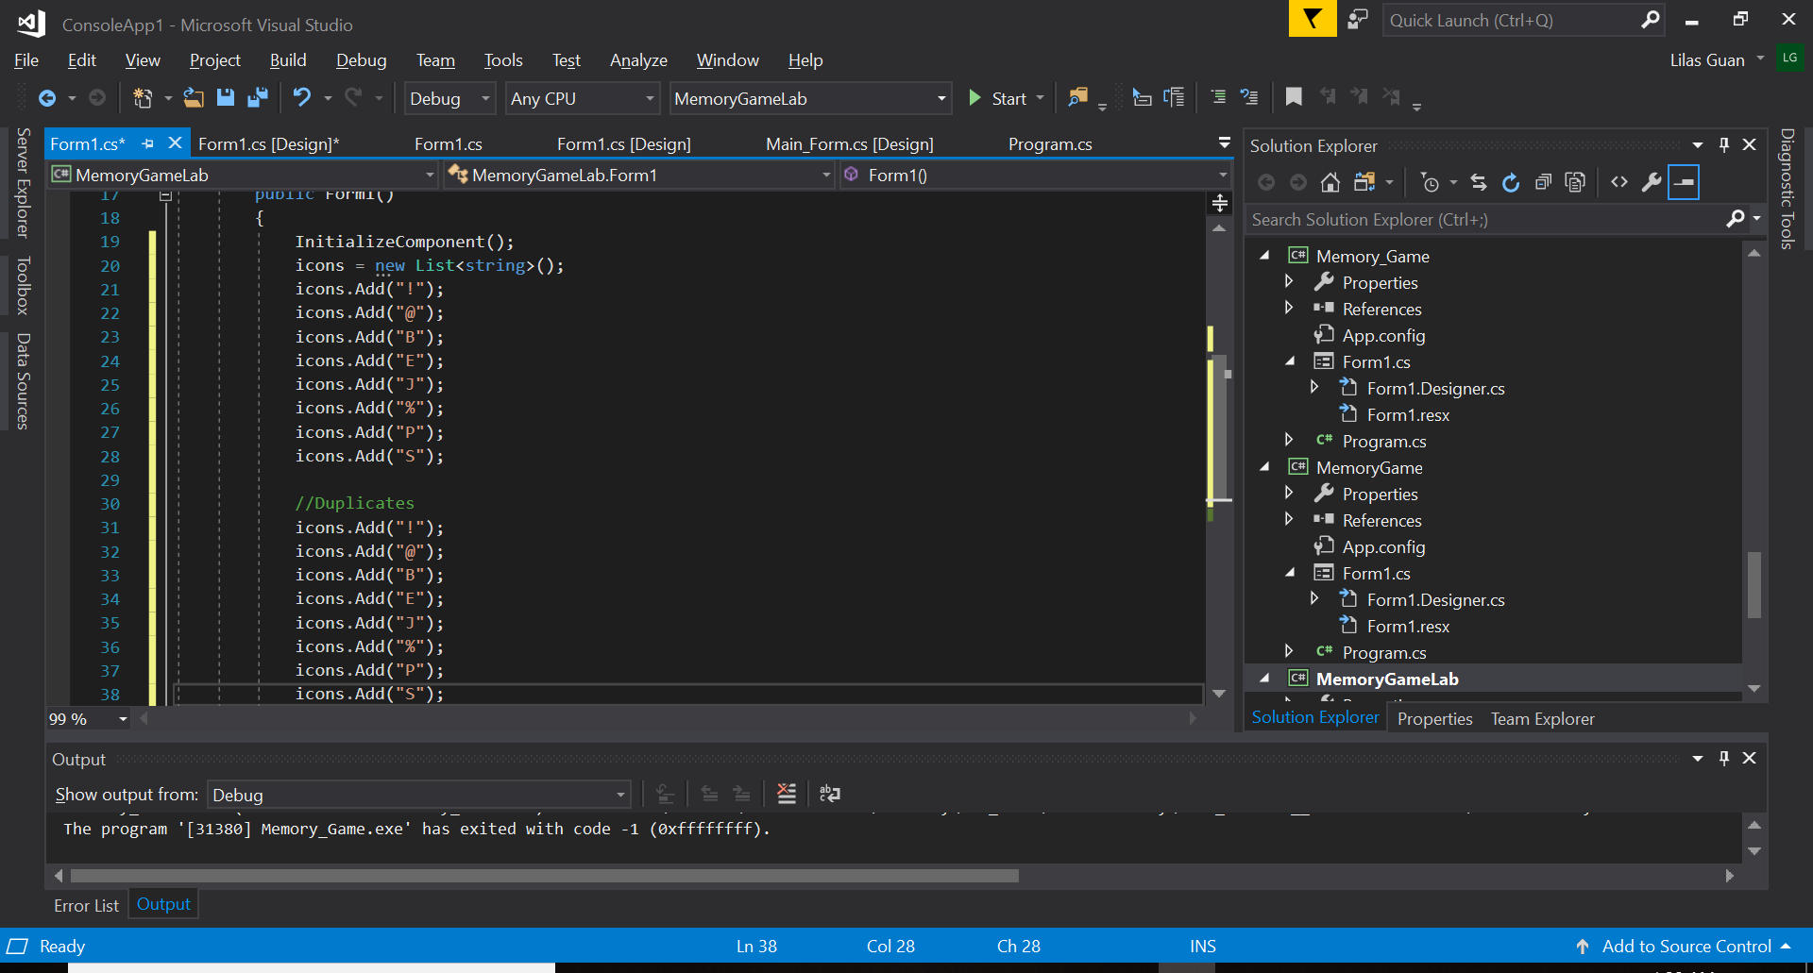
Now Serious Business, the code T-T
2. We’re making a memory game (find pairs) with 8 pairs of icons created by characters.
So go to the code and we’re going to create a List (kinda like vectors in C++) of strings called “icons” in which we’ll insert all the icons used for the game.
-> private List<string> icons;
We’ll create a list of strings in “public Form1()”
-> icons = new List<string>();
Then we’ll add our icons with “.Add()” like this :
-> icons.Add("!");
icons.Add("@");
icons.Add("B");
icons.Add("E");
icons.Add("J");
icons.Add("%");
icons.Add("P");
icons.Add("S");
*Don’t forget to create duplicates to make pairs (aka we need to do it twice with the same characters by copy-pasting it in the same list)

Slide 15
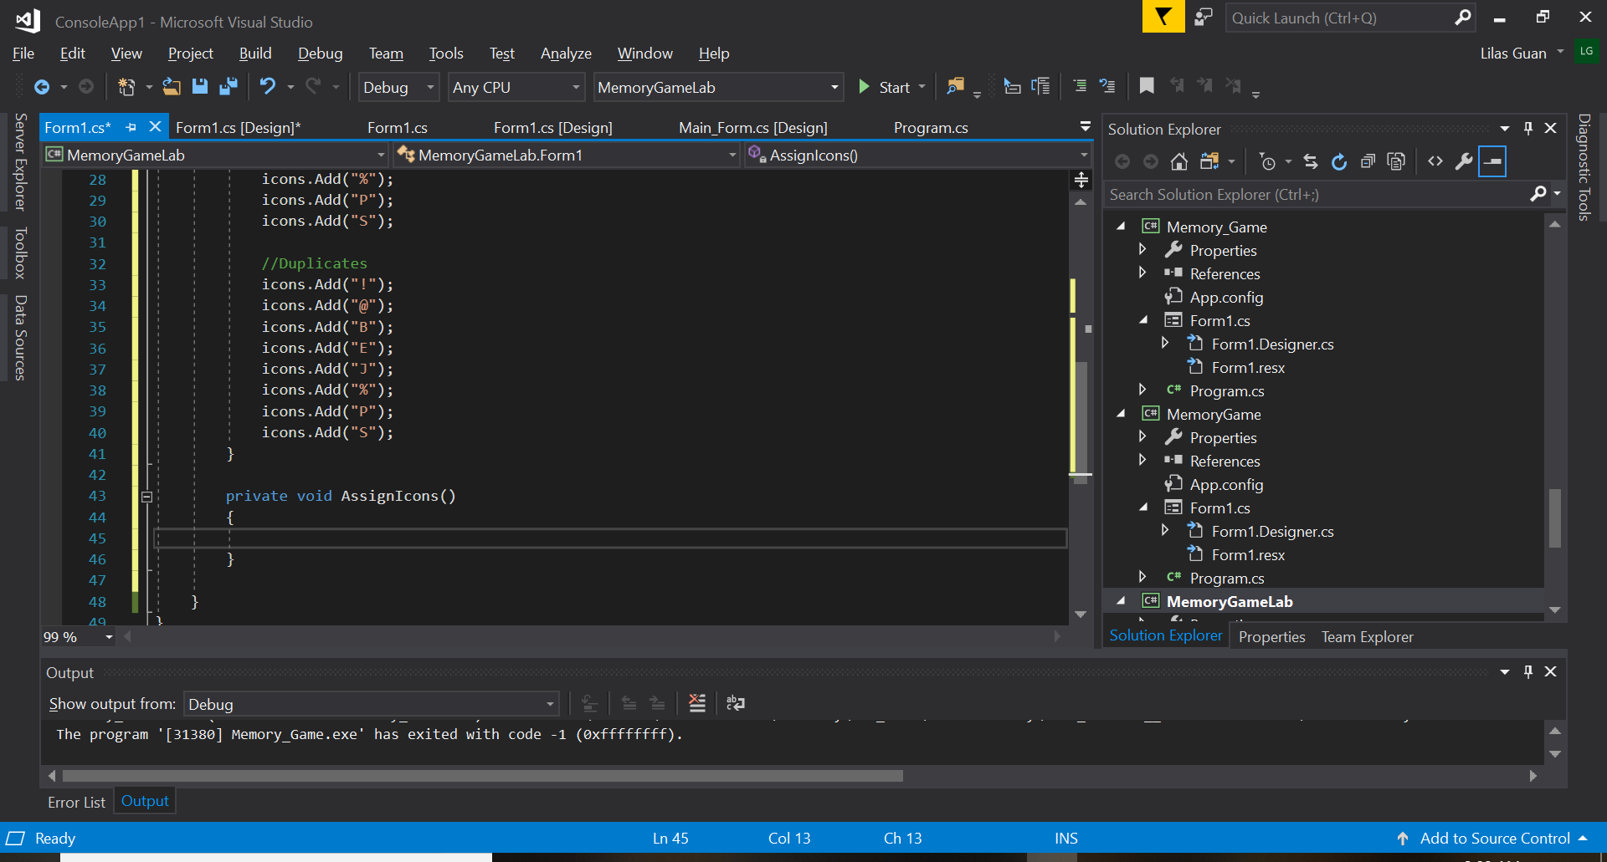
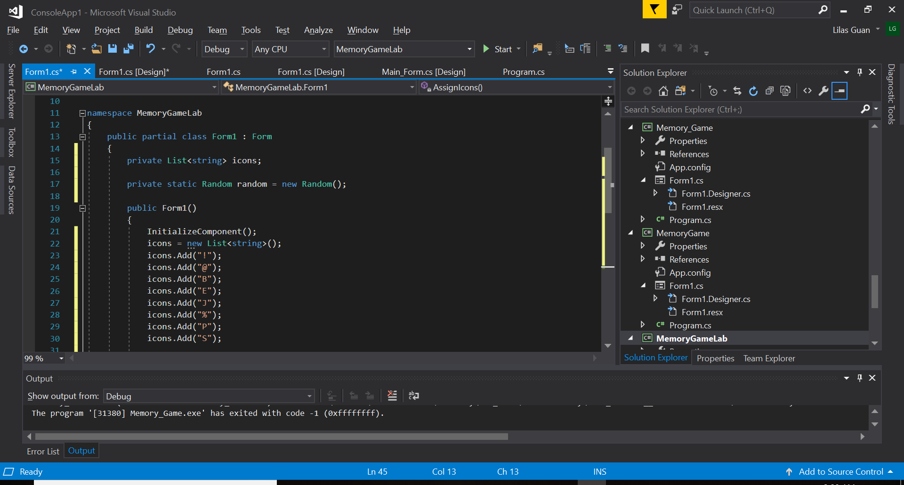
Now Serious Business, the code T-T
3. Now we want to have a function who will execute a random number (index) between 0 (the first index) and 15 (the last index).
So that it will distribute randomly the icons on each cases of our “tableLayoutPanel1” on “Form1” and remove a distributed icon from the list as the icons get distributed which will leave our list empty after the distribution is done while the cases will be left with a random icon that was from our list.
Let’s create the function now oxo”
-> private void AssignIcons()
{
}
In this function we need a random generator so :
-> private static Random random = new Random();
It’s static because we want to make sure there’s only one object random. We initialized it in the class because it is static. If it’s not static, then we would have initialized it in a constructor.
*The class random in C# is kinda special, if we have more than one object in memory, it won’t work, therefore we put it static so that even if we had created many objects of this class there would always only be one object in memory.

Slide 16
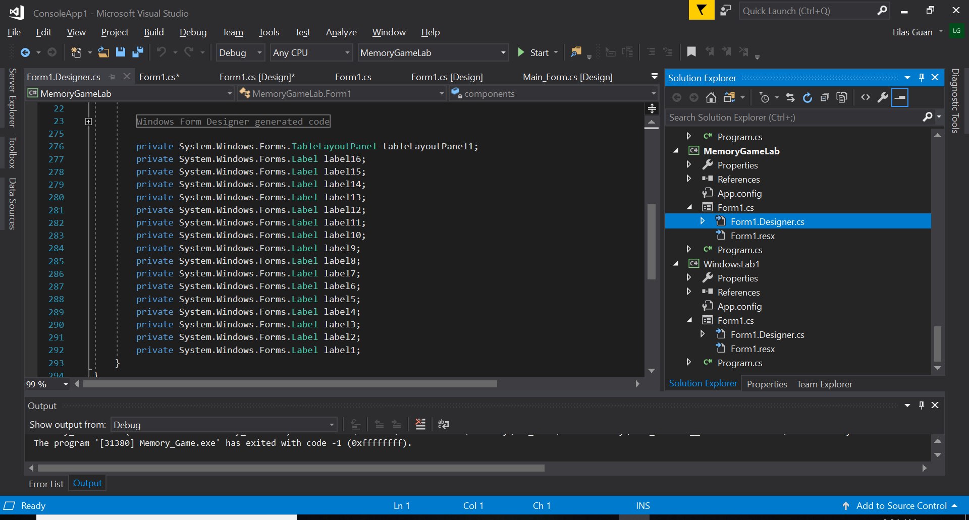
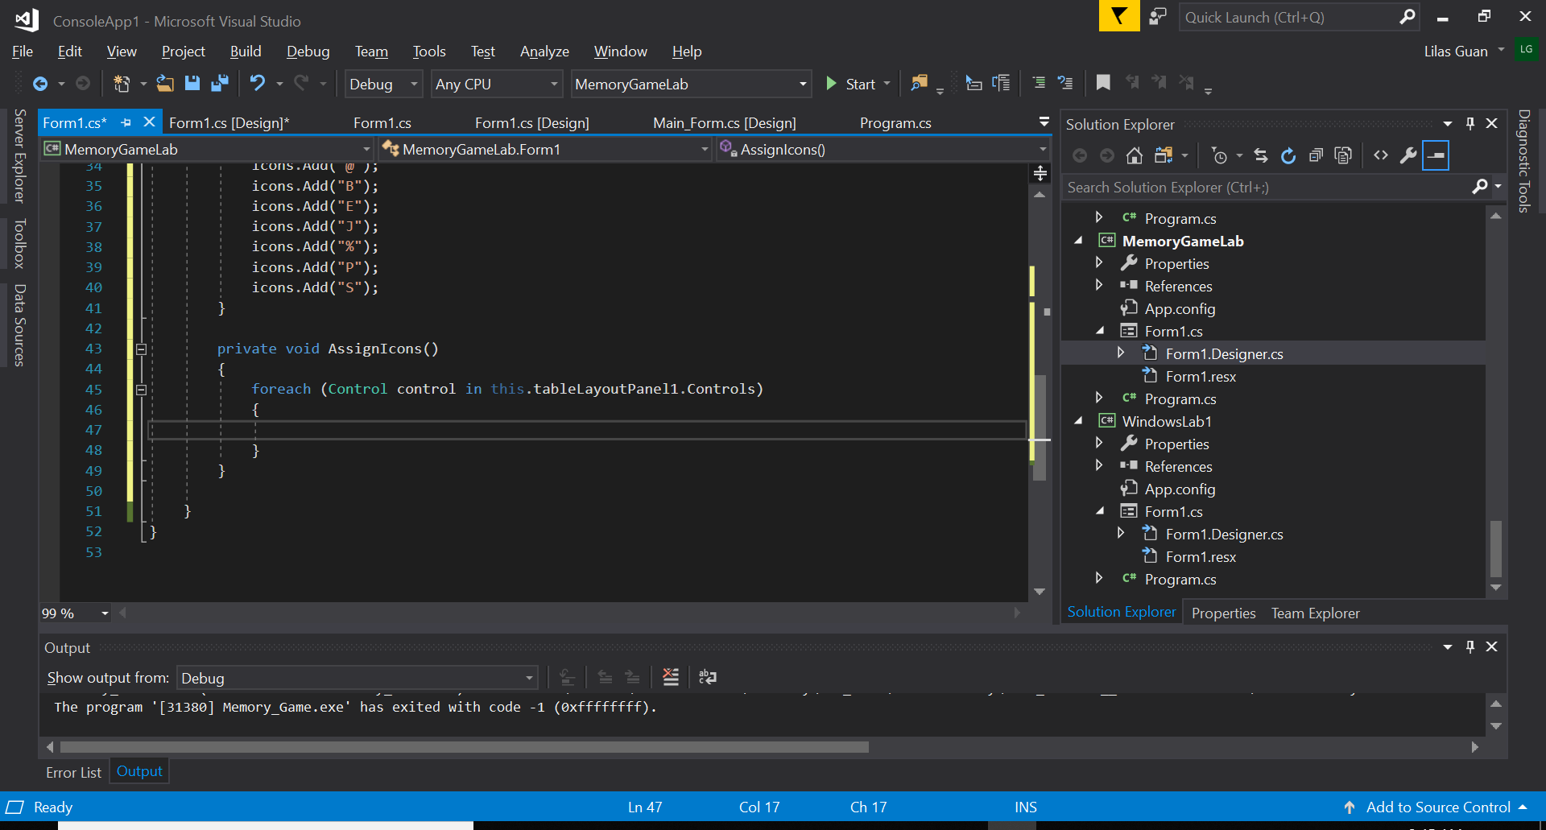
Now Serious Business, the code T-T
4. We’ll have to call our object random in our function to generate numbers in memory each time we’re giving an index where an icon must be added.
But before that, just going to show where our icons are stored. Since we’re using a “TableLayoutPanel”, all the labels are in the list of controls of our “tableLayoutPanel1”. When we double click on “Form1.Designer.cs” under our current project, we can see that our labels are added in the list of controls of our “tableLayoutPanel1”.
So if we want to have access to these labels, we have to do a “foreach” loop “Control in” and we have to use our “tableLayoutPanel1.Controls” and not “this.Controls” because our labels aren’t directly in “Form1”, they are in our “tableLayoutPanel1”. We’ll use that to find all our labels that exist in it.
-> private void AssignIcons()
{
foreach(Control control in this.tableLayoutPanel1.Controls)
{
}
}

Slide 17
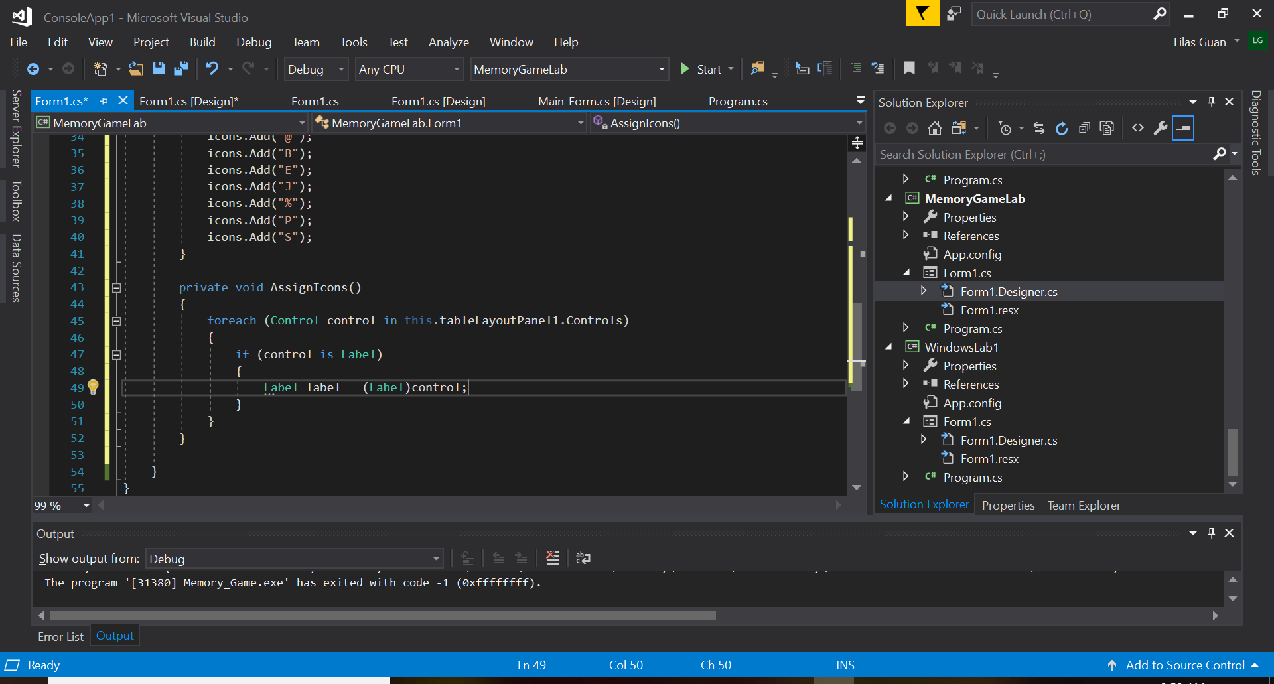
Now Serious Business, the code T-T
5. If we want to read a “Control”, we must convert it in “Label”.
-> private void AssignIcons()
{
foreach(Control control in this.tableLayoutPanel1.Controls)
{
if(control is Label)
{
Label label = (Label)control;
}
}
}
*A Control is controls in general, it can be a button, a label, etc. Anything that can be added from the “Toolbox” can be considered as a Control.
We’re only interested in our labels in this case. If we had other things in our “Form1” and you want to make sure it’s really a control of Label type, we can do “if(control is Label) {}” to test it and if it’s really a Label, we’ll create a Label and convert the control into Label because we want to have access to all the properties of Label. As a Control, we don’t have access to all the properties of that same object (in this case Label).

Slide 18
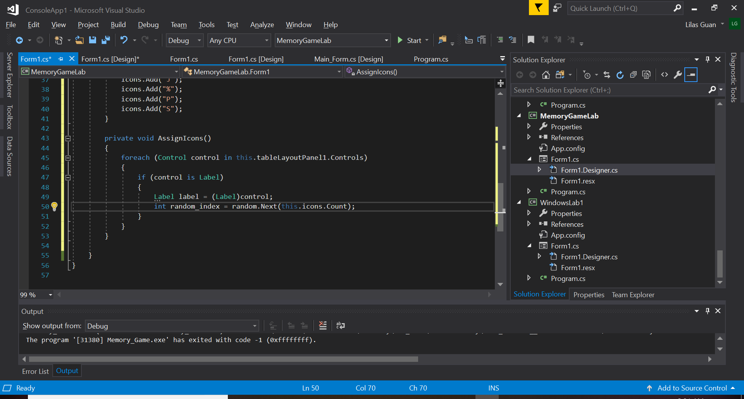
Now Serious Business, the code T-T
6. We must change the text of our labels with our icons that we chose in our list “icons”. So now we need our random generator to distribute our icons randomly to each space (represented by indexes) in our “tableLayoutPanel1” in our “Form1”.
-> int random_index = random.Next(this.icons.Count);
We create an integer for our indexes which will be generated by our random generator.
“.Next()” is where we’ll give the maximum value (the value put in “.Next()” will never be included in the generator aka we have 16 icons but it will generate values from 0 to 15) and “Count” refers to the number of items which in this case is our number of icons in the list “icons”.

Slide 19
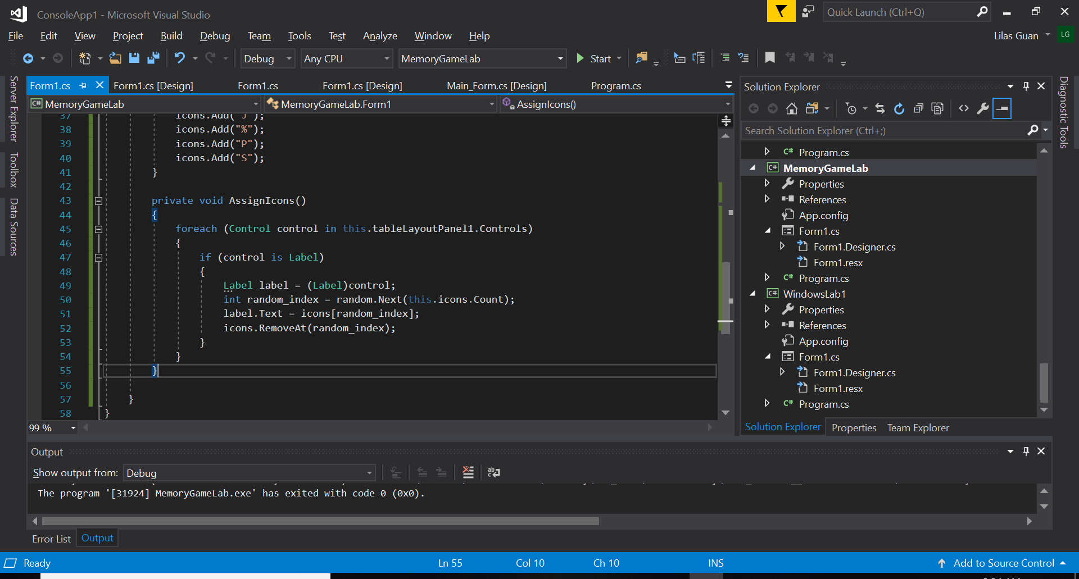
Now Serious Business, the code T-T
7. So what we’re gonna do is to make sure our icons, which will be distributed at random index, is read as our label text in our “Form1”
-> label.Text = icons[random_index];
After an icon from our list as been distributed to a space (index) in our “Form1”, we would want to remove it from the list (hopefully so that it doesn’t get distributed again or something).
-> icons.RemoveAt(random_index);

Slide 20
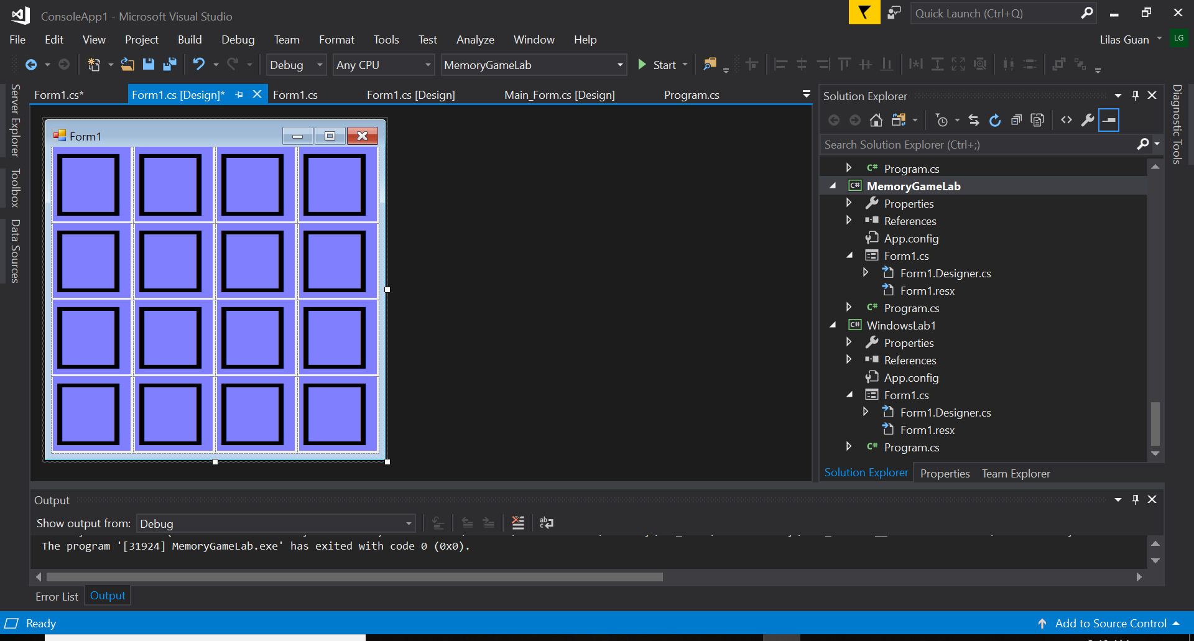
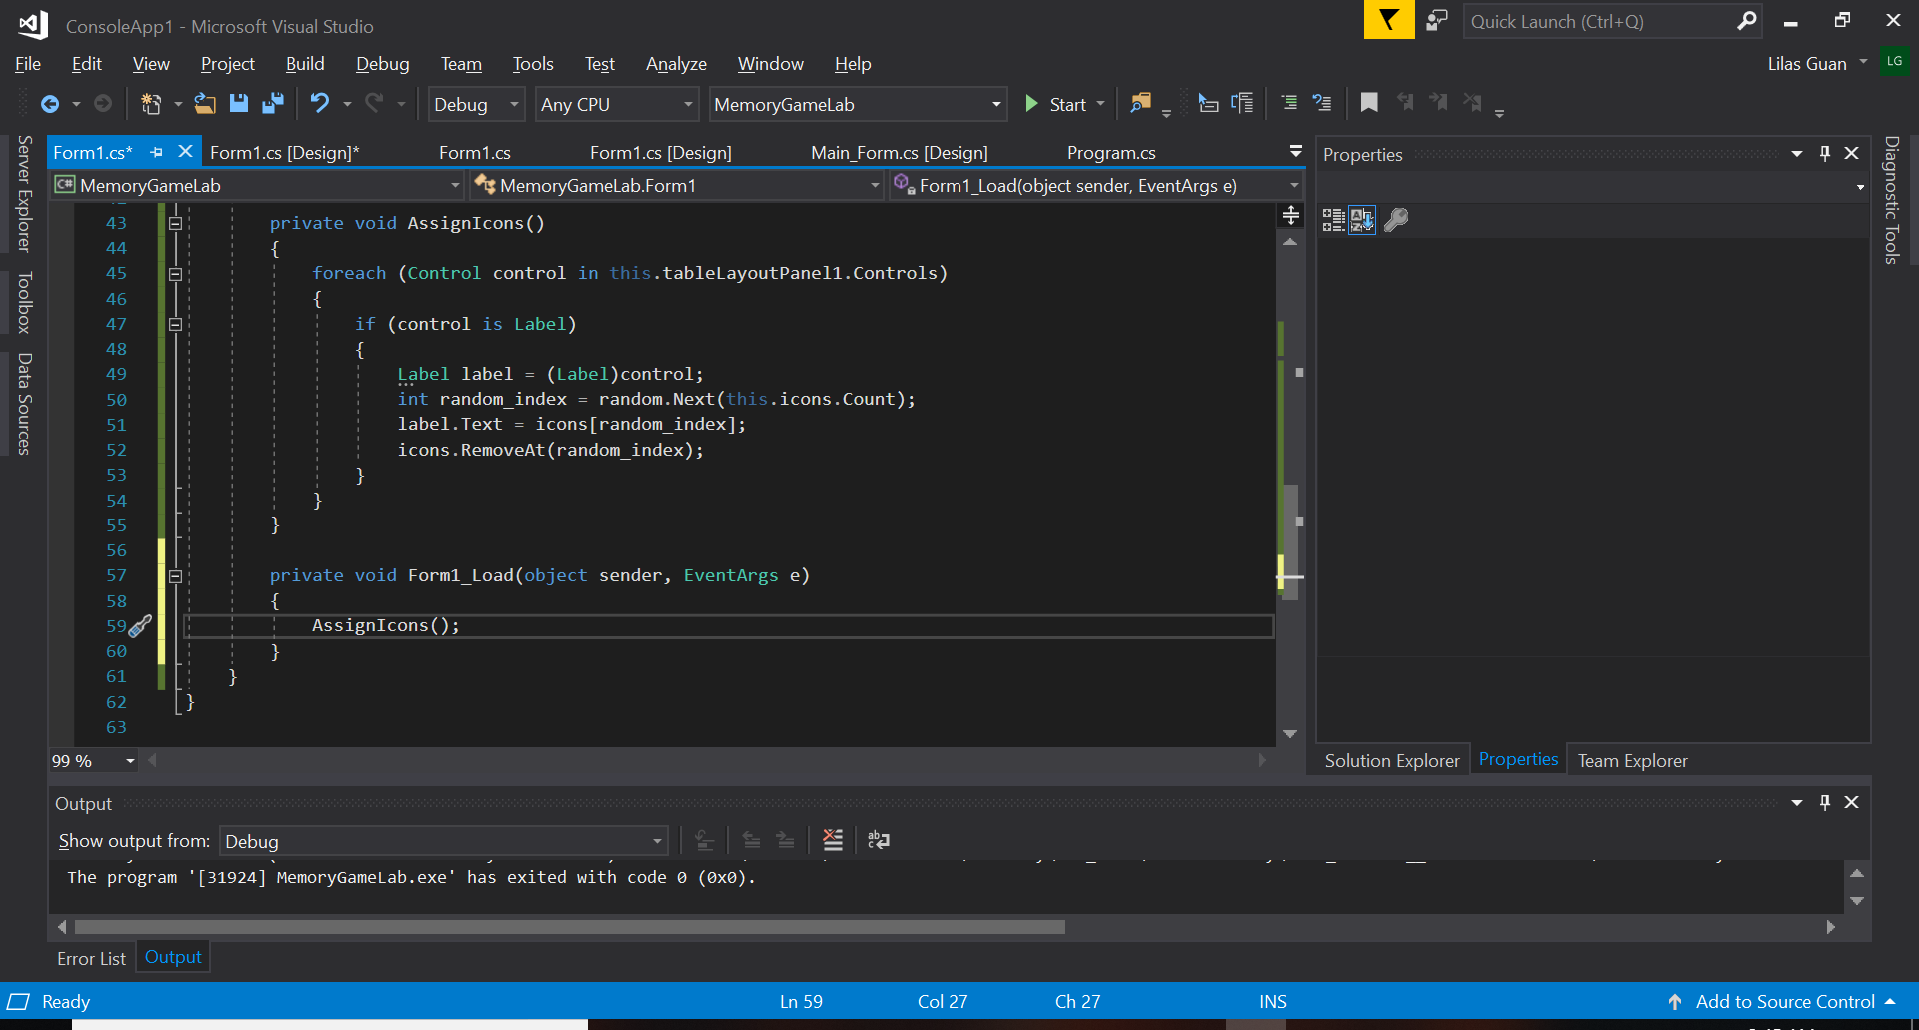
Now Serious Business, the code T-T
8. Go back to our “Form1.cs [Design]” and double click on our “Form1”.
It’s going to generate a method automatically in our code (as an event Load).
Inside that method, let’s call our function “AssignIcons()” so that it can be applied on our form when we run the application.
-> AssignIcons();

Slide 21
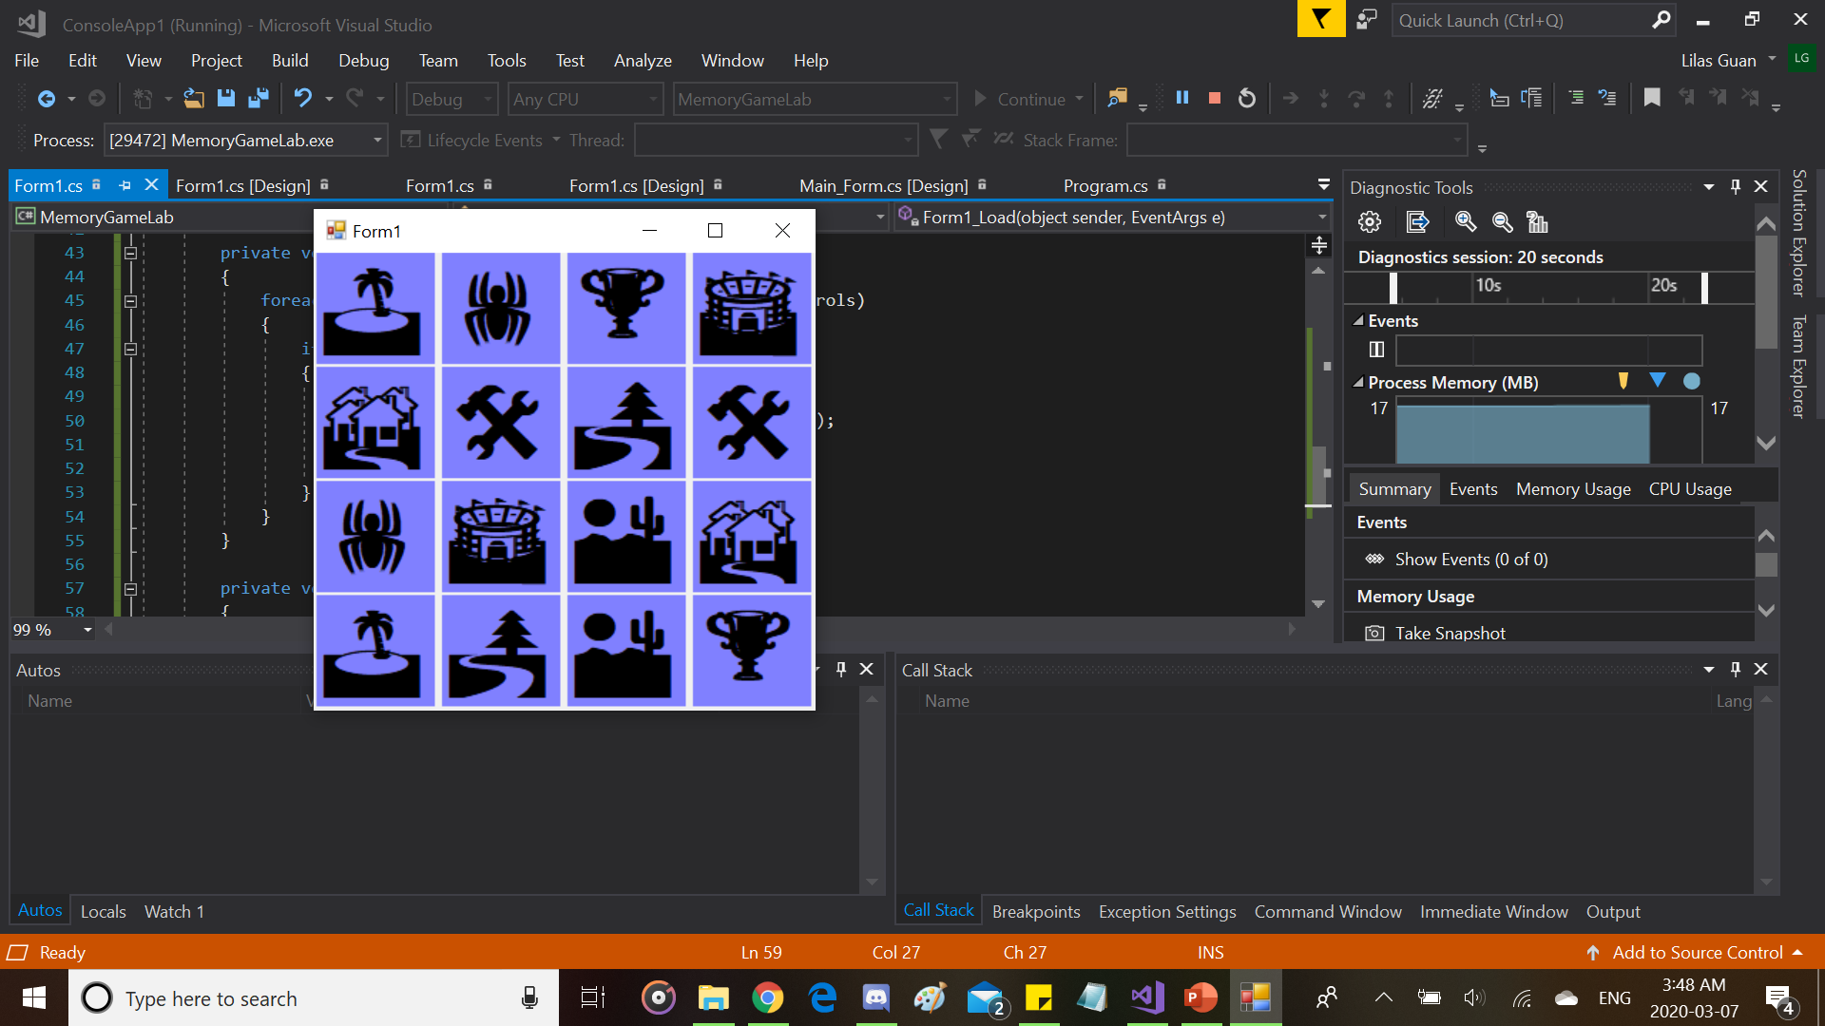
The Result should look like this When running the app at this point!

Slide 22
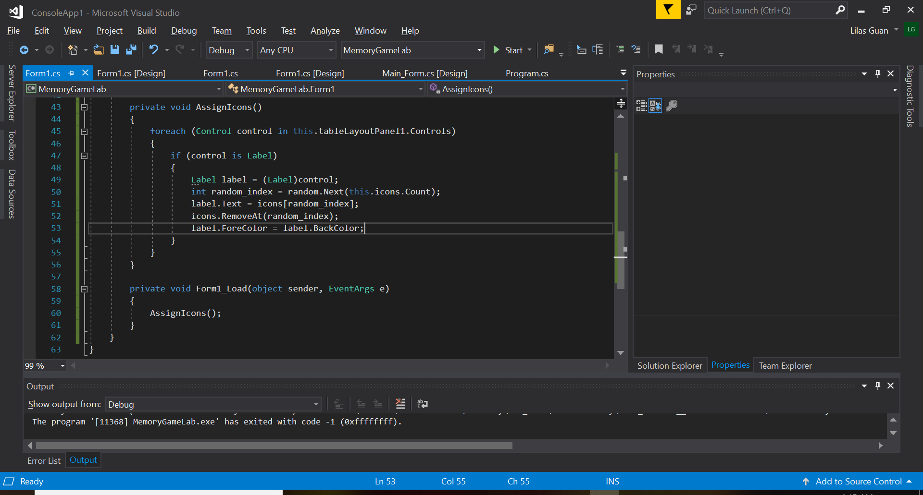
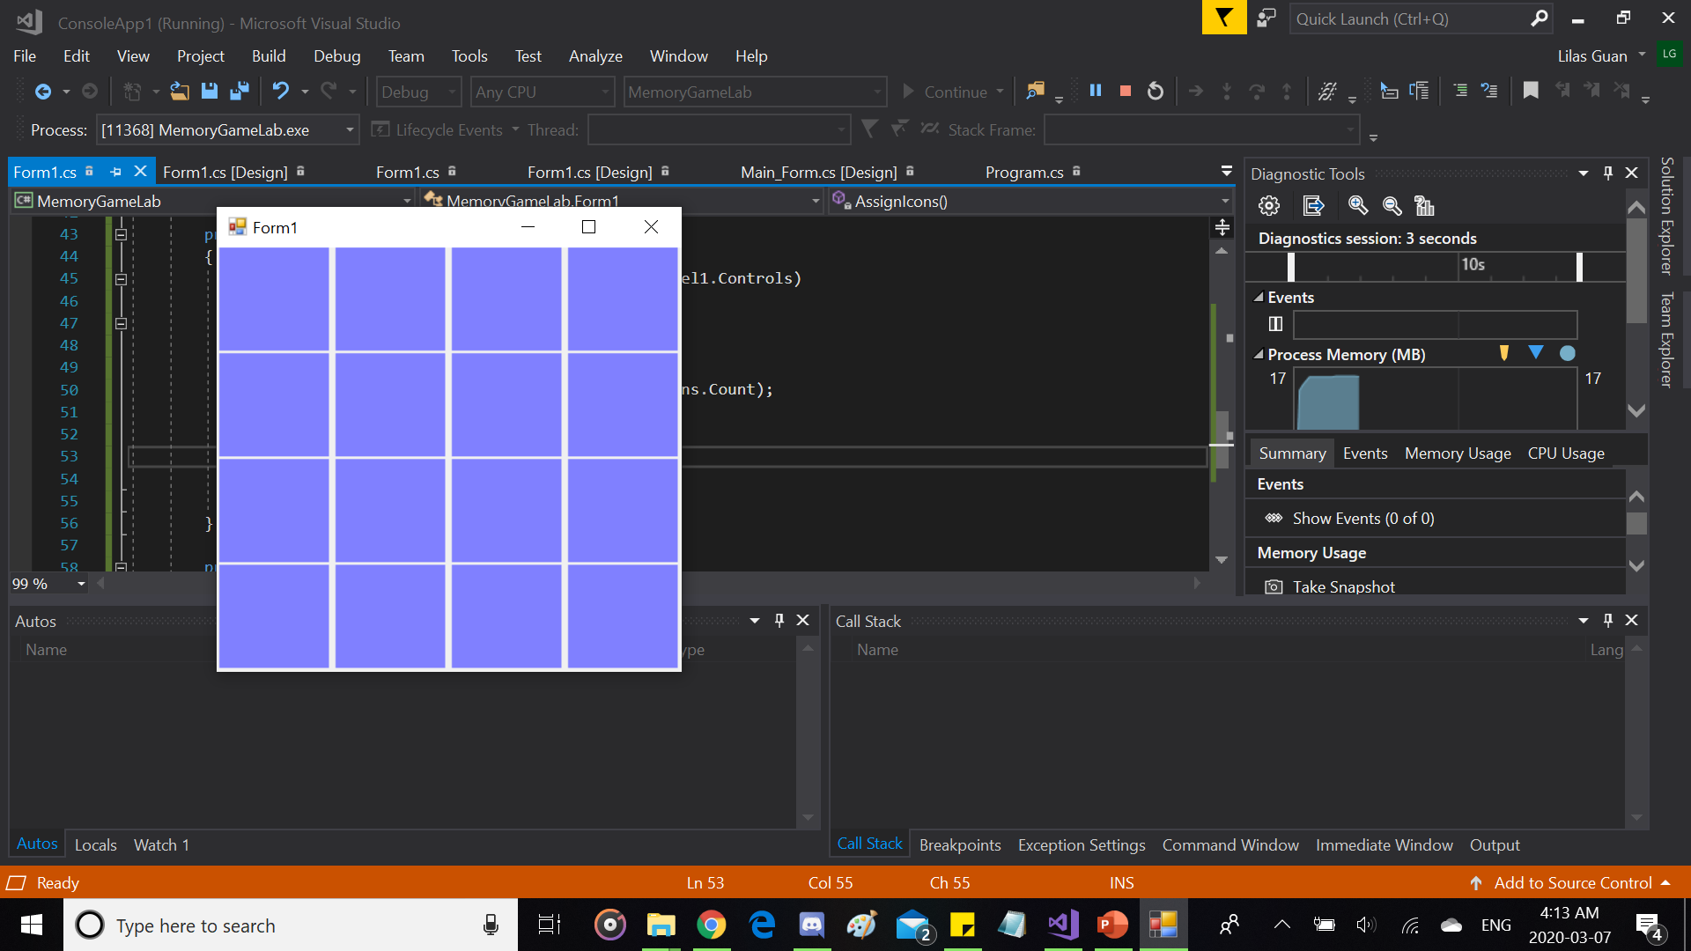
Now Serious Business, the code T-T (Continue)
Now we want to hide our icons which are also our label text without hiding the label itself. We will put the fore color and the back color as a same one color that’s all. The icons are still there but it’s not really visible to us as it’s the same color as the background color :,)
-> label.ForeColor = label.BackColor;
After that, the icons should be hidden when running the application.

Slide 23
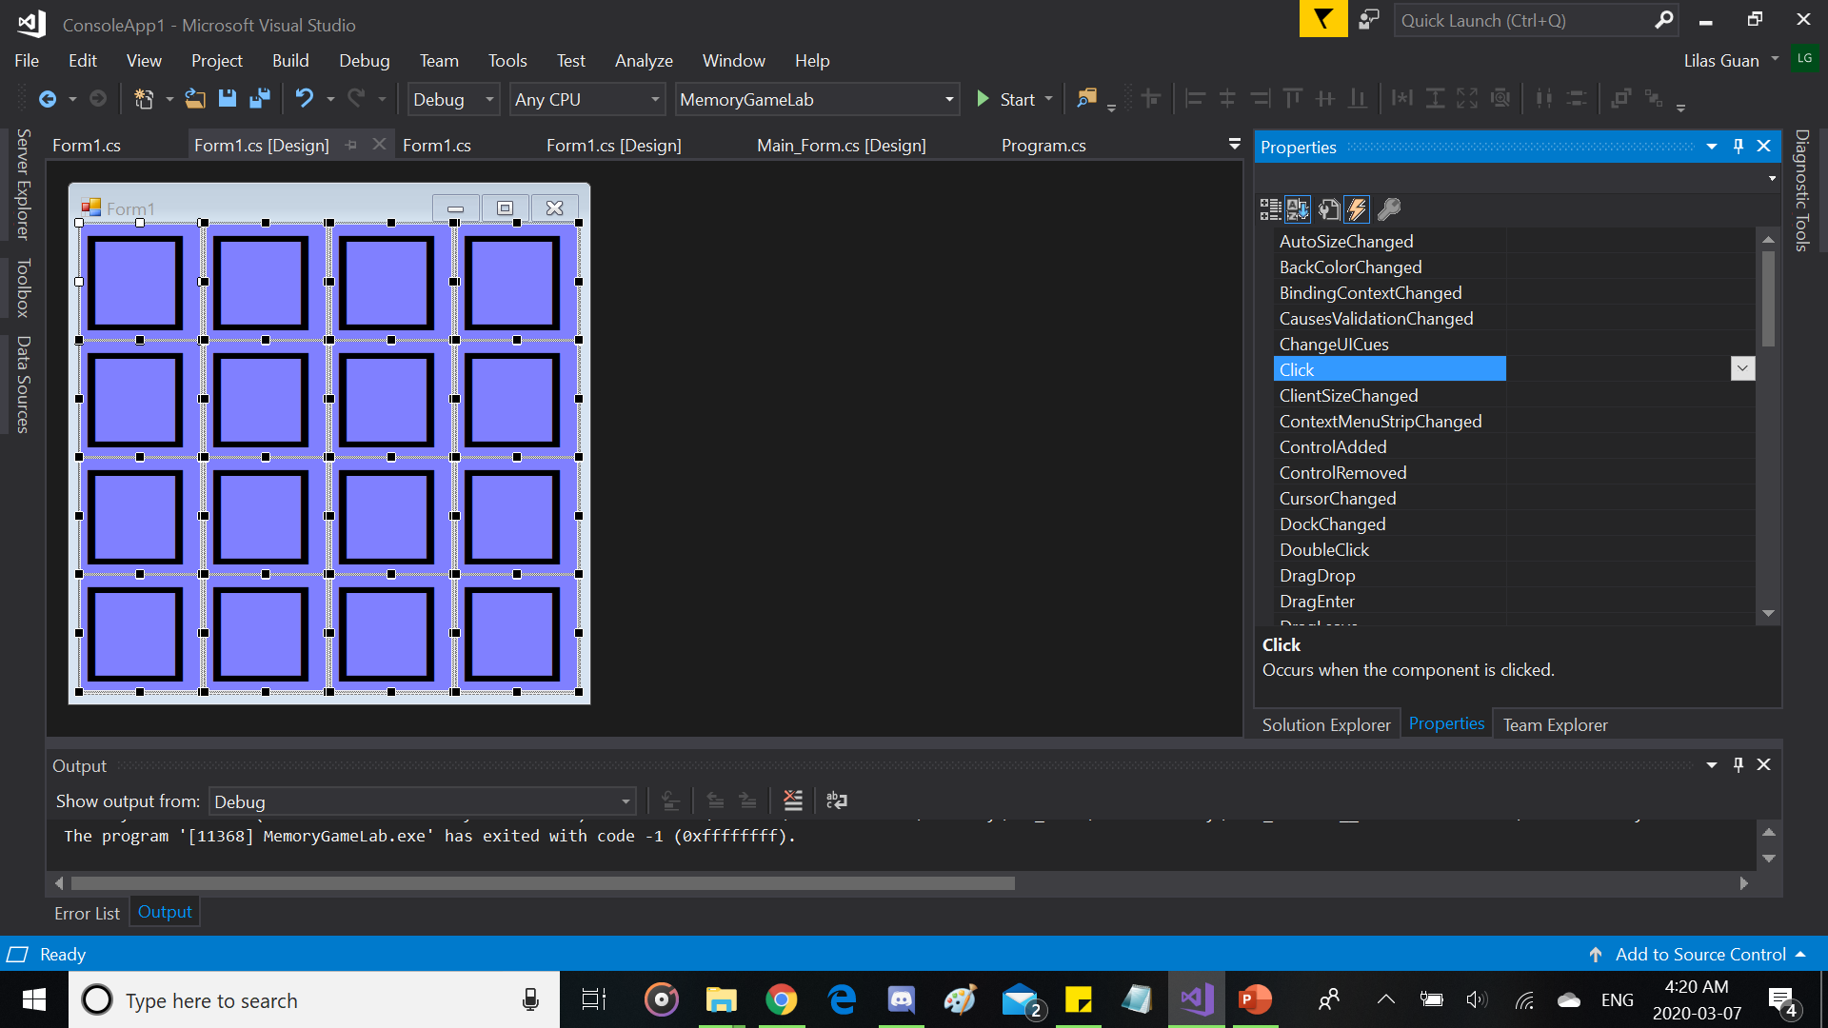
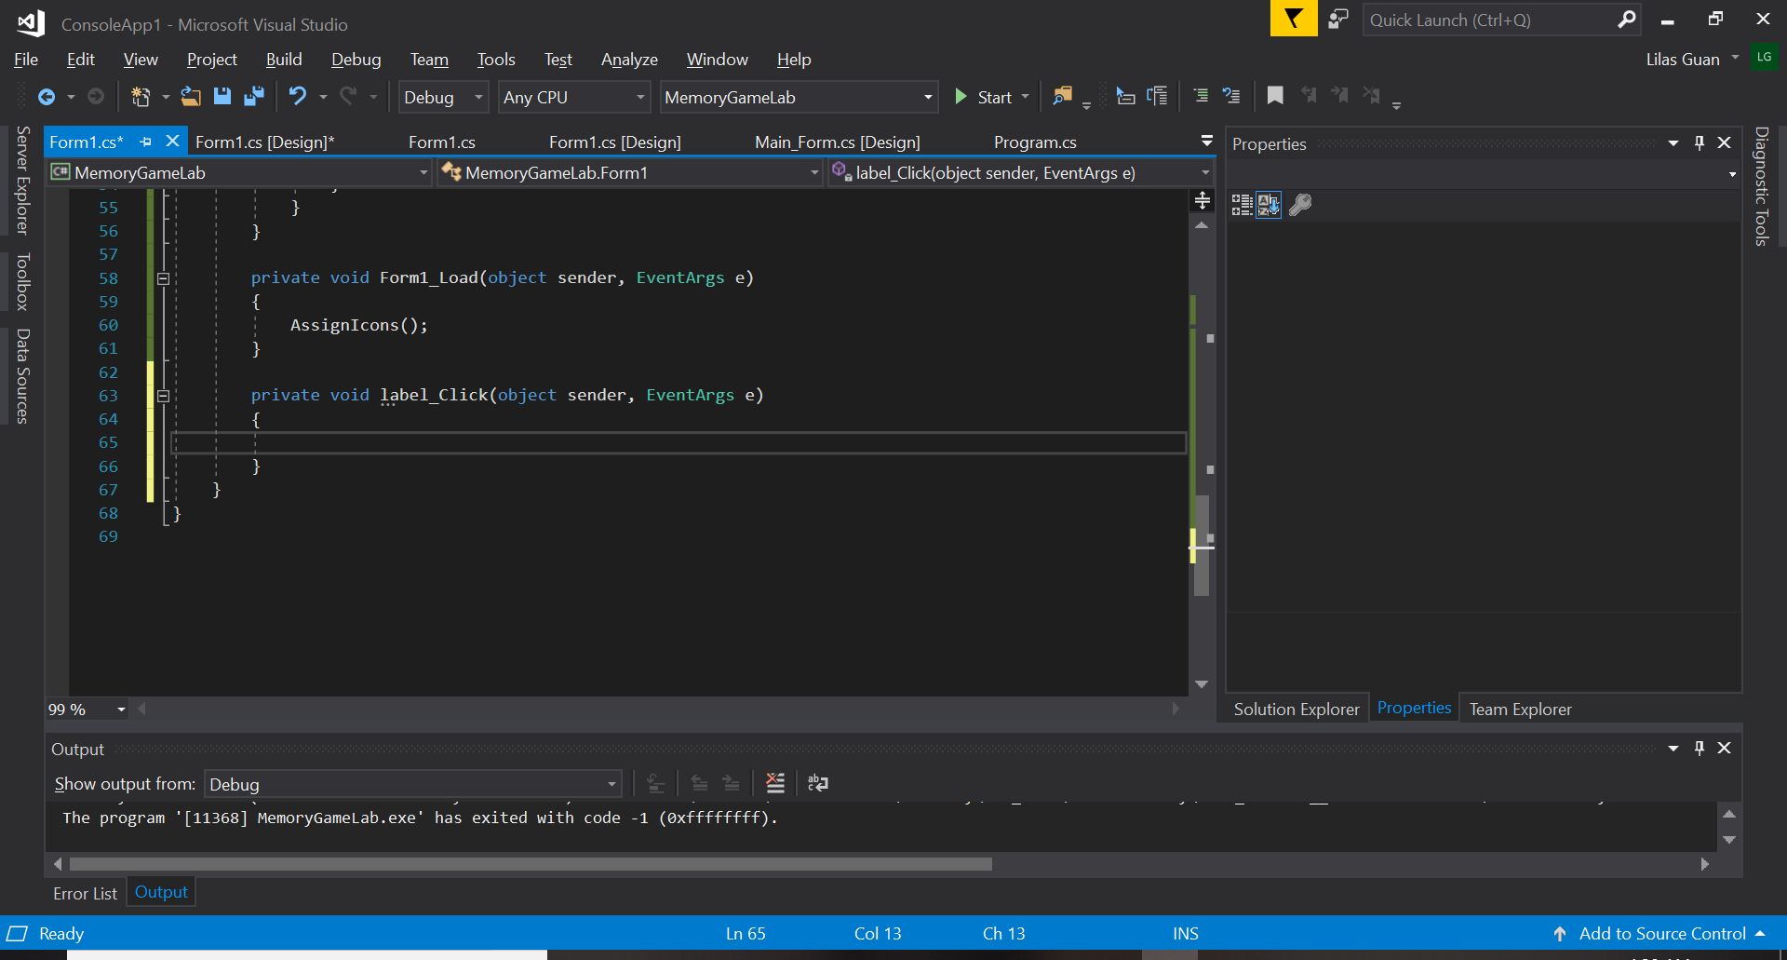
Now Serious Business, the code T-T (Continue)
2. Go back to “Form1.cs [Design]” and select all the labels we have put on our “tableLayoutPanel1” (You can click one of the case, hold Shift on your keyboard and click the rest of the cases in it).
Go to Events (Lightning Icon) and double click on the event “Click”, it will automatically create a method in our code.
Go back again to “Form1.cs [Design]” and in Events where “Click” is, rename the event to “label_Click”, it will rename the method in our code as well (Rename it from the Events and not from the code).

Slide 24
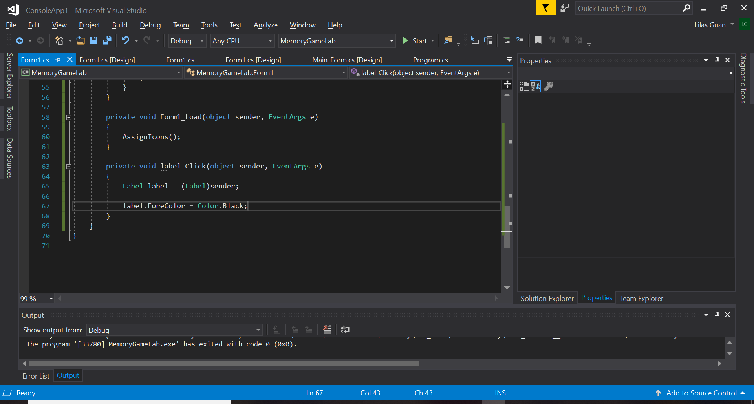
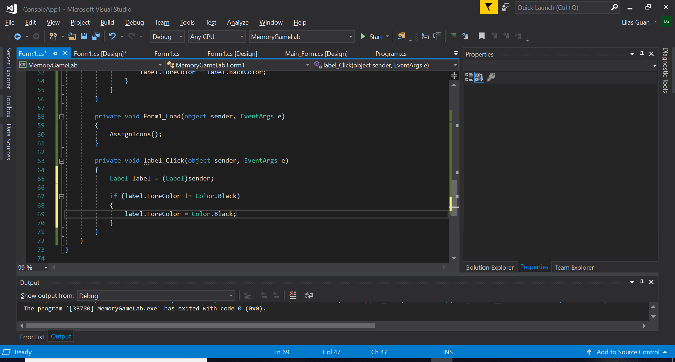
Now Serious Business, the code T-T (Continue)
3. We need to convert the "sender" as a Label to access the properties of text so we can turn the icons black and visible again.
We’ll create a Label to convert the sender in Label.
-> Label label = (Label)sender;
Now we can change the property “ForeColor”
-> label.ForeColor = Color.Black;
Now we don’t want to just change the “ForeColor” to black but we want the application to know that when it’s already black, it means we have already played with this label. So we will create an “if” statement.
-> if(label.ForeColor != Color.Black)
{
label.ForeColor = Color.Black;
}

Slide 25
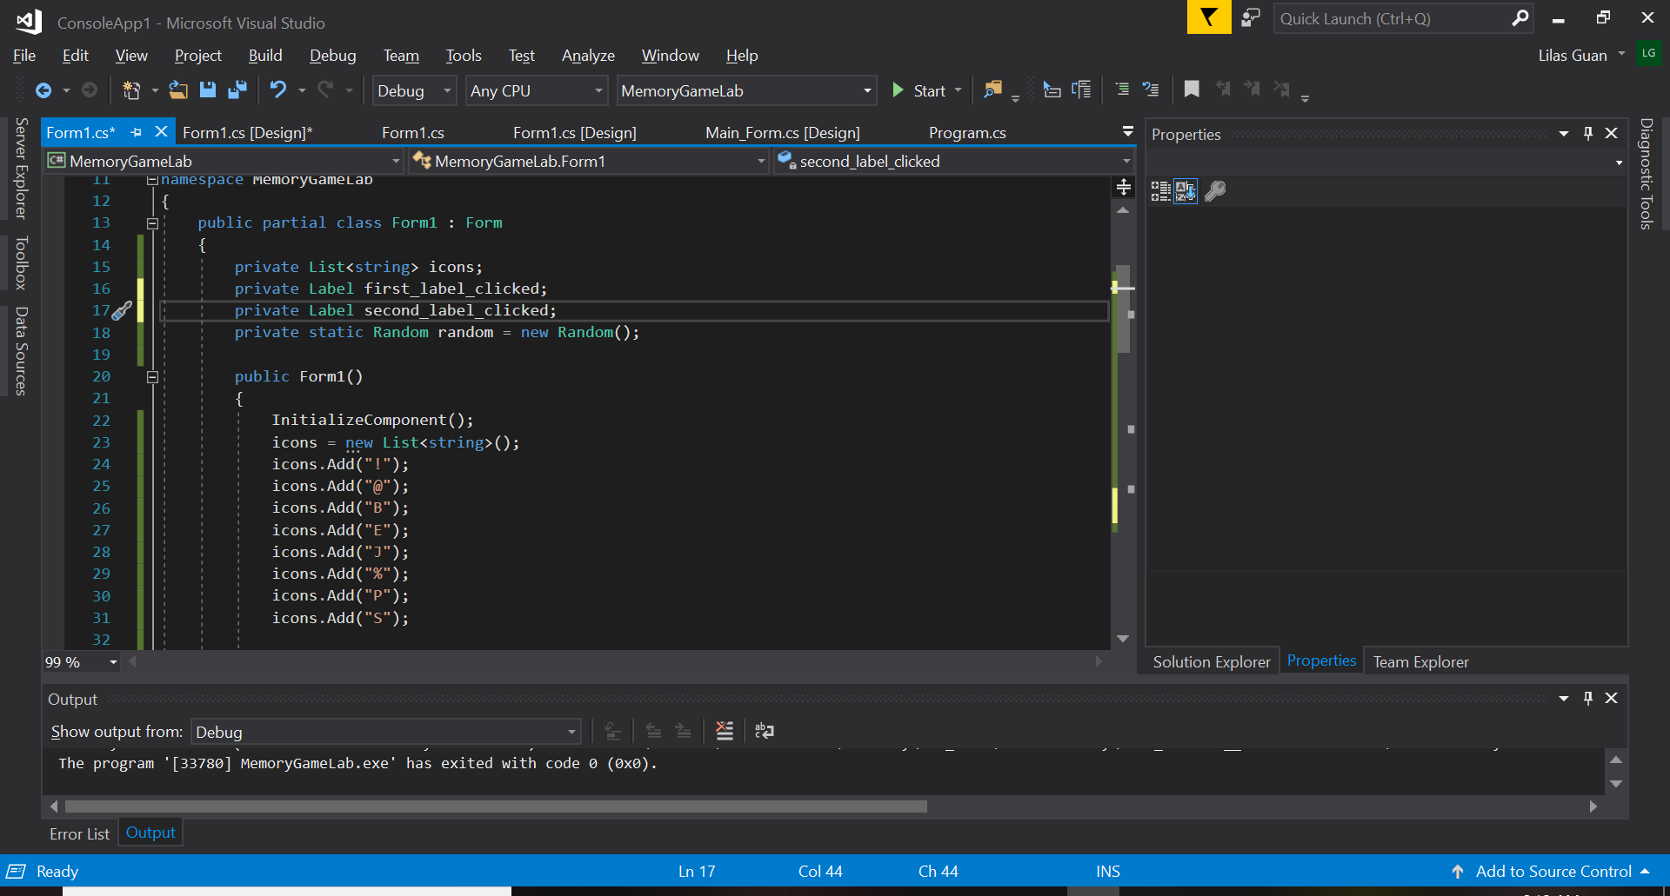
Now Serious Business, the code T-T (Continue)
4. When playing a memory game, you have to reveal two icons at a time. We need to know the first icon that was clicked and the second icon clicked during a turn in the game. We also need to compare the two icons that was clicked (whether they were the same or not).
If they are not the same, we need to revert the “ForeColor” to “BackColor” to hide them again. If they are the same, they should stay revealed.
So we need two global variables because we’ll use them in many methods so we’ll put them in the class.
-> private Label first_label_clicked;
private Label second_label_clicked;

Slide 26
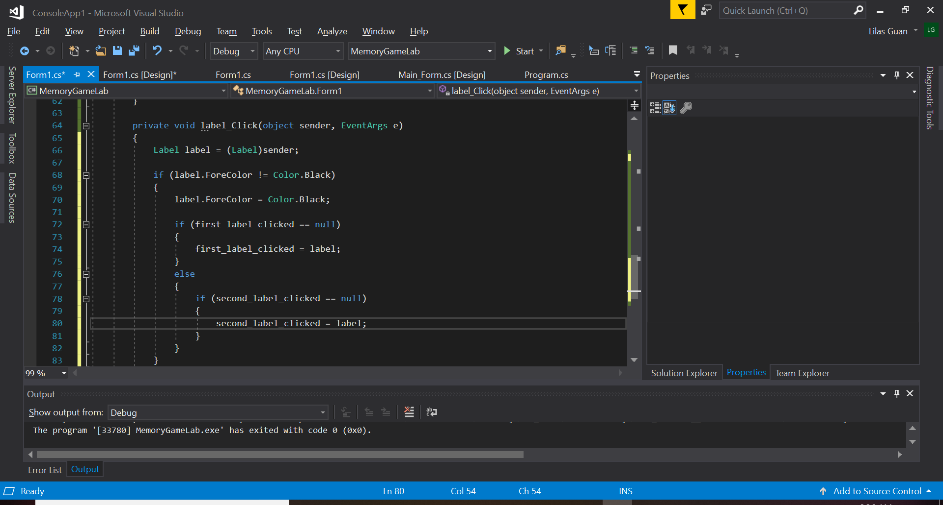
Now Serious Business, the code T-T (Continue)
5. In the beginning, our labels are null, the variables are empty. The first click on a label will be counted as the first label if it’s empty. If it’s not empty, it will be counted as the second label.
(It’s like putting the label you clicked on in the first index out of 2 indexes that is empty. If the first one is not empty then it will be put in the second index which is empty.)
-> if(first_label_clicked == null)
{
first_label_clicked = label;
}
else
{
if(second_label_clicked == null)
{
second_label_clicked = label;
}
}

Slide 27
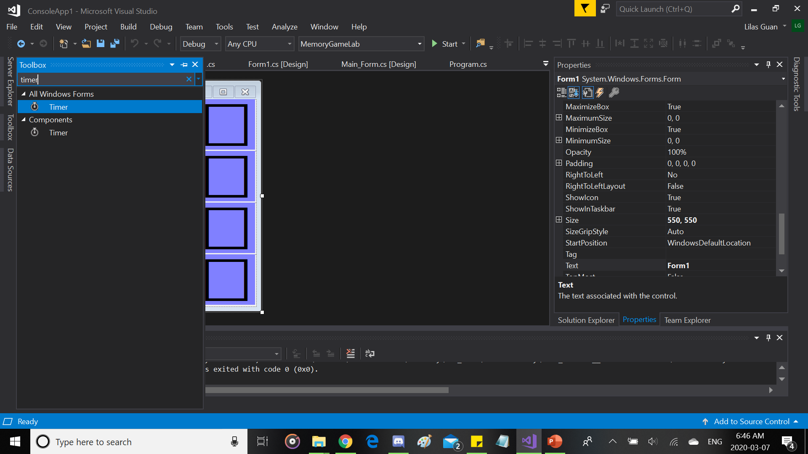
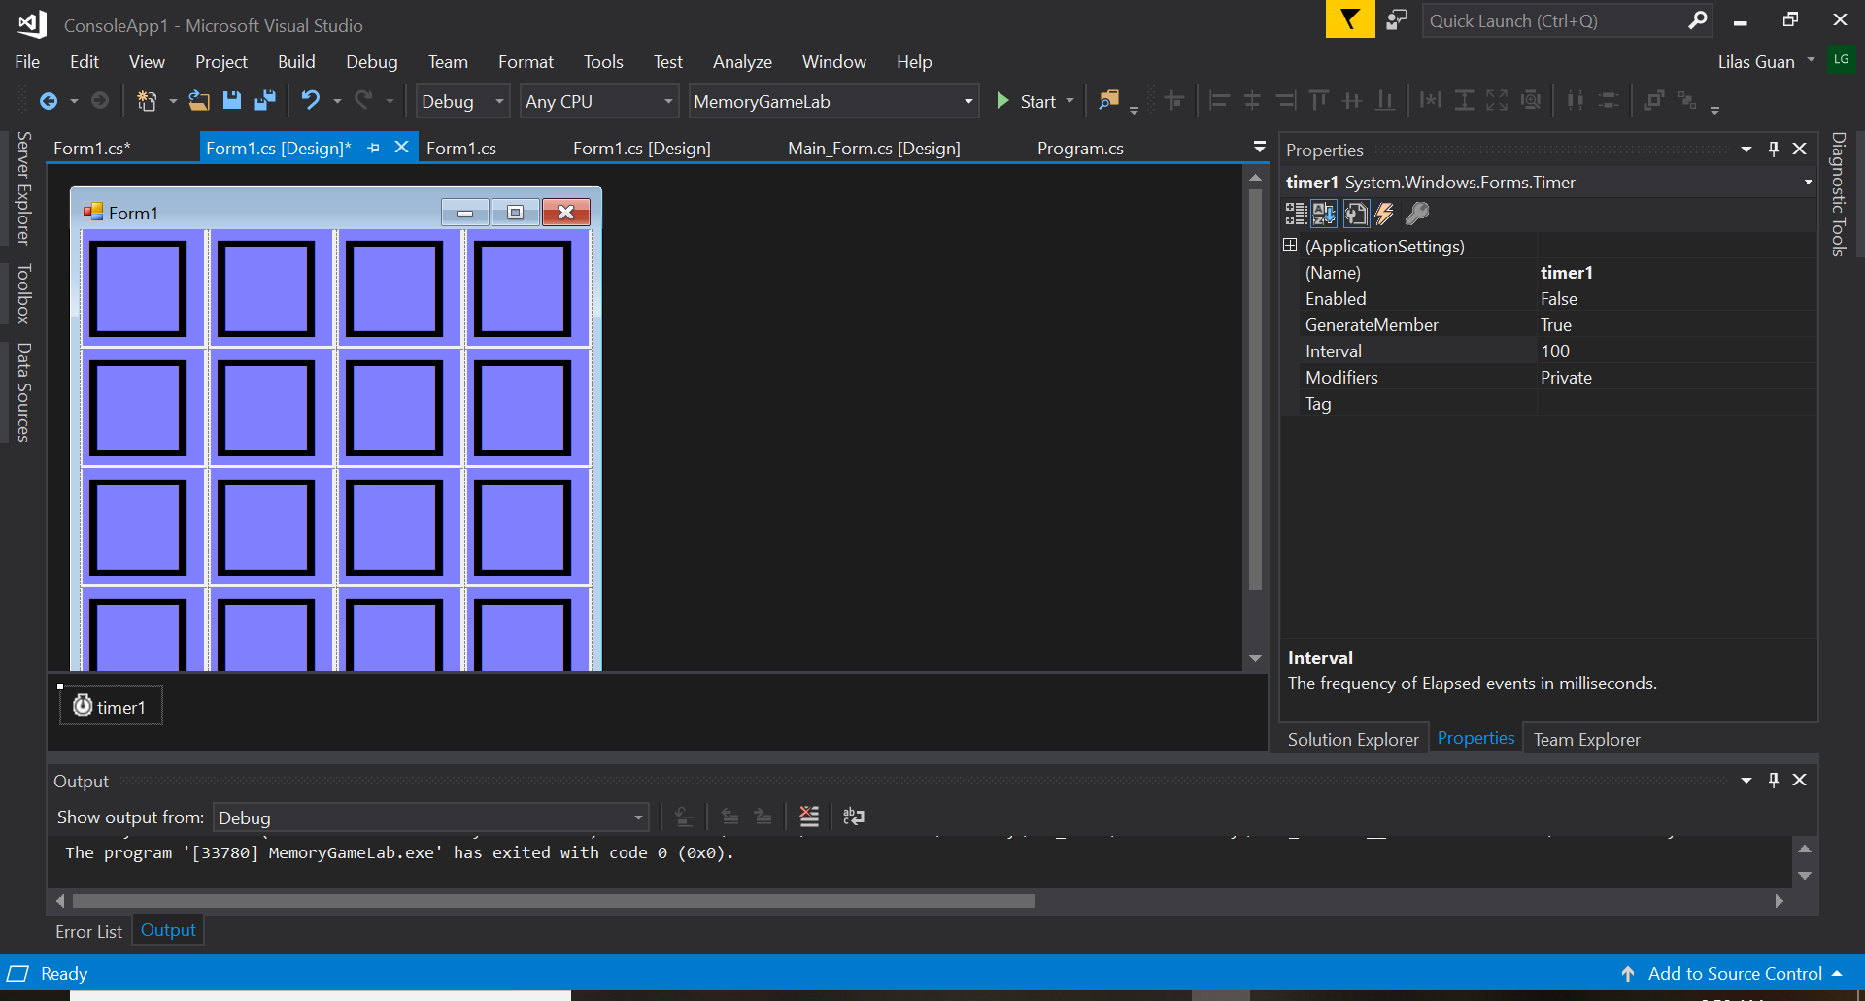
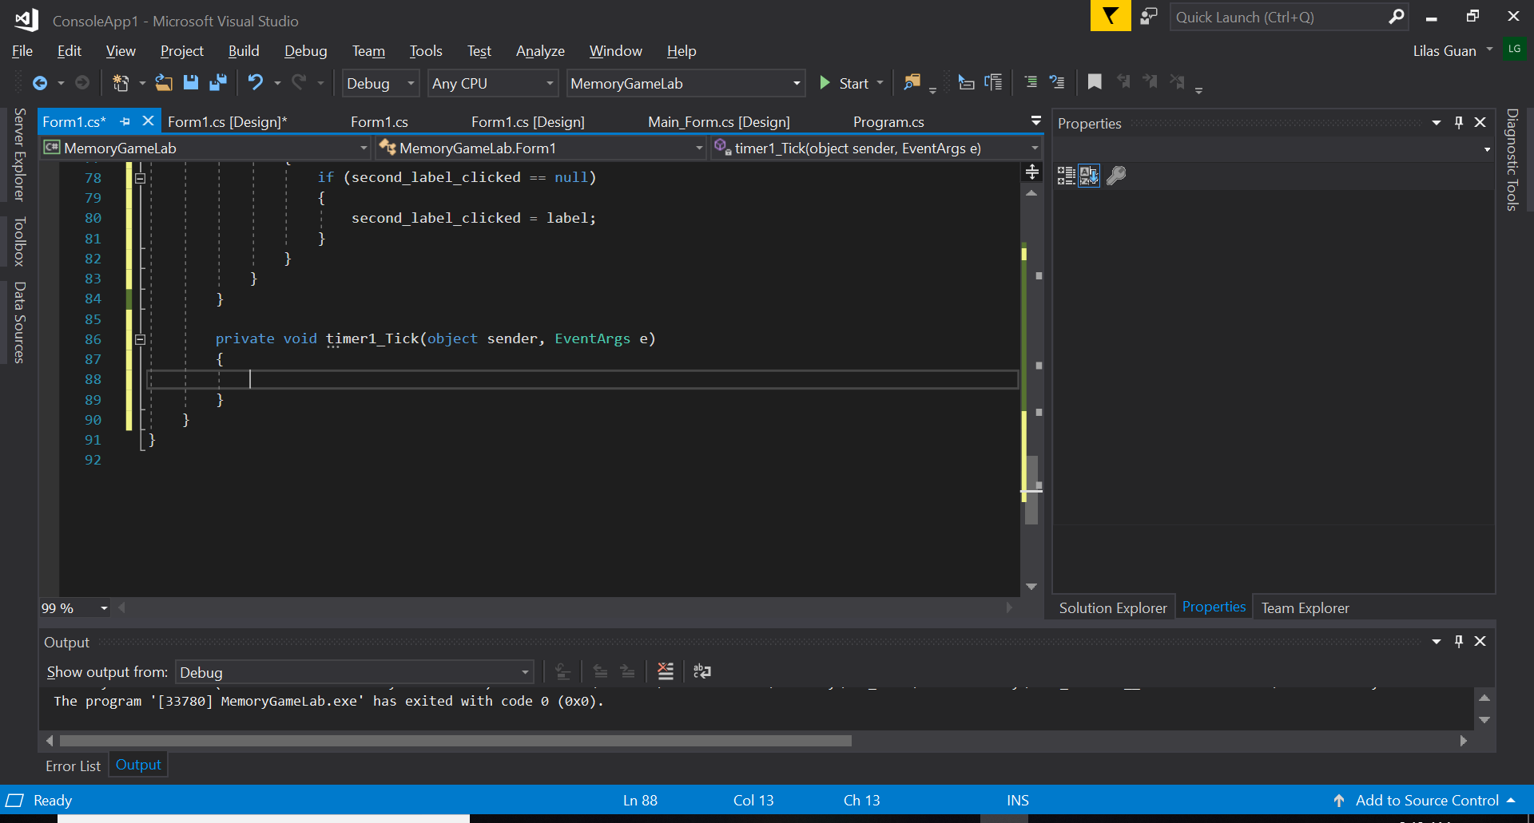
Now Serious Business, the code T-T (Continue)
6. Now the thing is, when you execute the application and click on a second label, if the two labels you clicked weren’t the same. They will be hidden again so fast that you can’t even see what was the second label’s icon that you clicked. So we need to add a timer.
Let’s return to “Form1.cs [Design]” and go to “Toolbox” to find a “Timer” and just double click it when you find it.
Once you did, it will add a timer. Then double click the timer (timer1) you just added so that it creates an event “Tick” in the code.

Slide 28
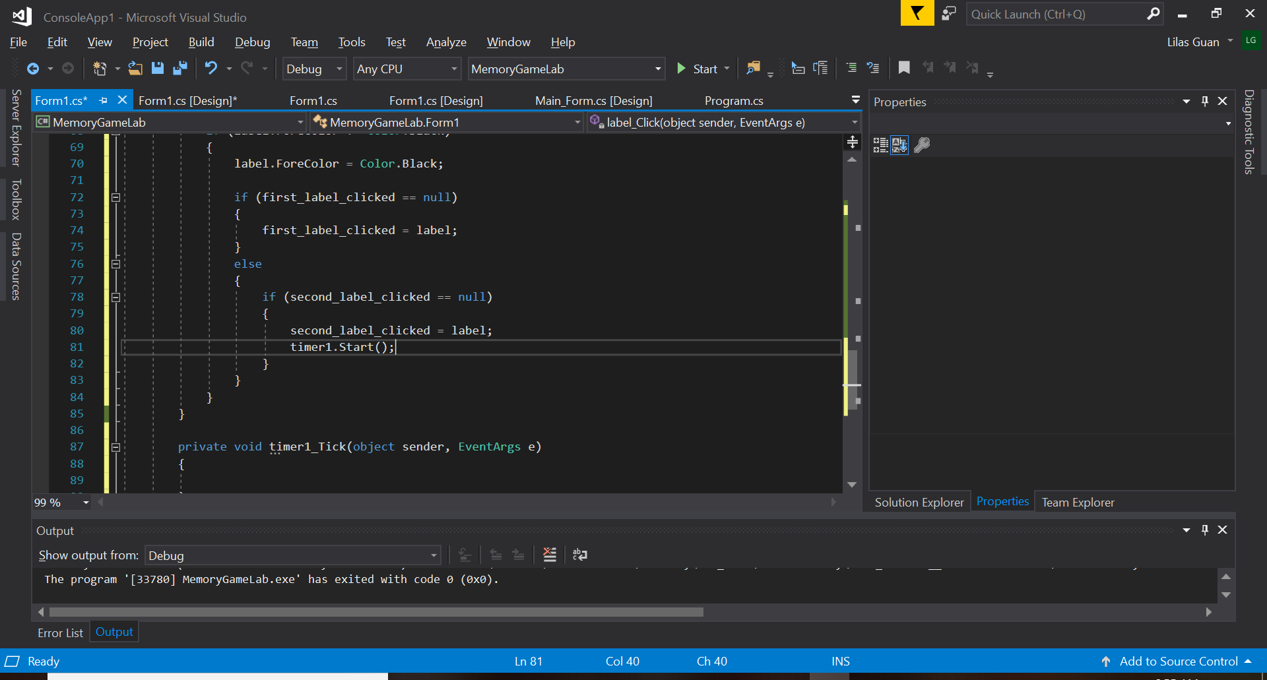
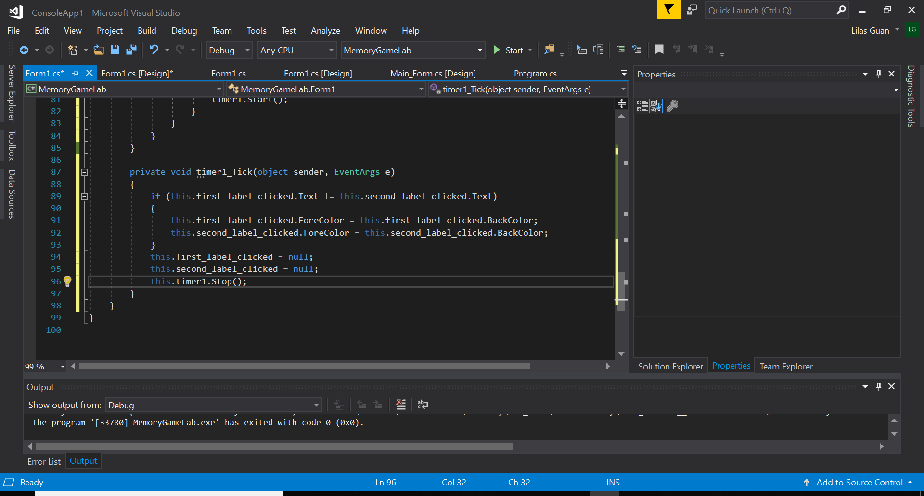
Now Serious Business, the code T-T (Continue)
7. Now that we have a timer, we would like it that it starts counting after a second icon was revealed after our second click in the turn so that gives us time to see what were the two labels’ icons that we clicked on.
-> timer1.Start();
We want to verify the text (icons) of our labels if they matched or not. We’ll create an “if” statement which is if the icons (text) clicked don’t match together, their “ForeColor” (Black) will revert to the BackColor of the label.
Then we’ll have to reset kinda (empty the indexes of choices so that we can restart the turn) and finally stop the timer (aka when the two labels that were picked ended up being a pair or not, the turn is over).
Still even if the both labels were the same, we need to make our global variables null again to make another turn to find the pairs left (so it has to be outside the “if” statement, same for the “timer1.Stop()”).
-> if (this.first_label_clicked.Text != this.second_label_clicked.Text)
{
this.first_label_clicked.ForeColor = this.first_label_clicked.BackColor;
this.second_label_clicked.ForeColor = this.second_label_clicked.BackColor;
}
this.first_label_clicked = null;
this.second_label_clicked = null;
this.timer1.Stop();

Slide 29
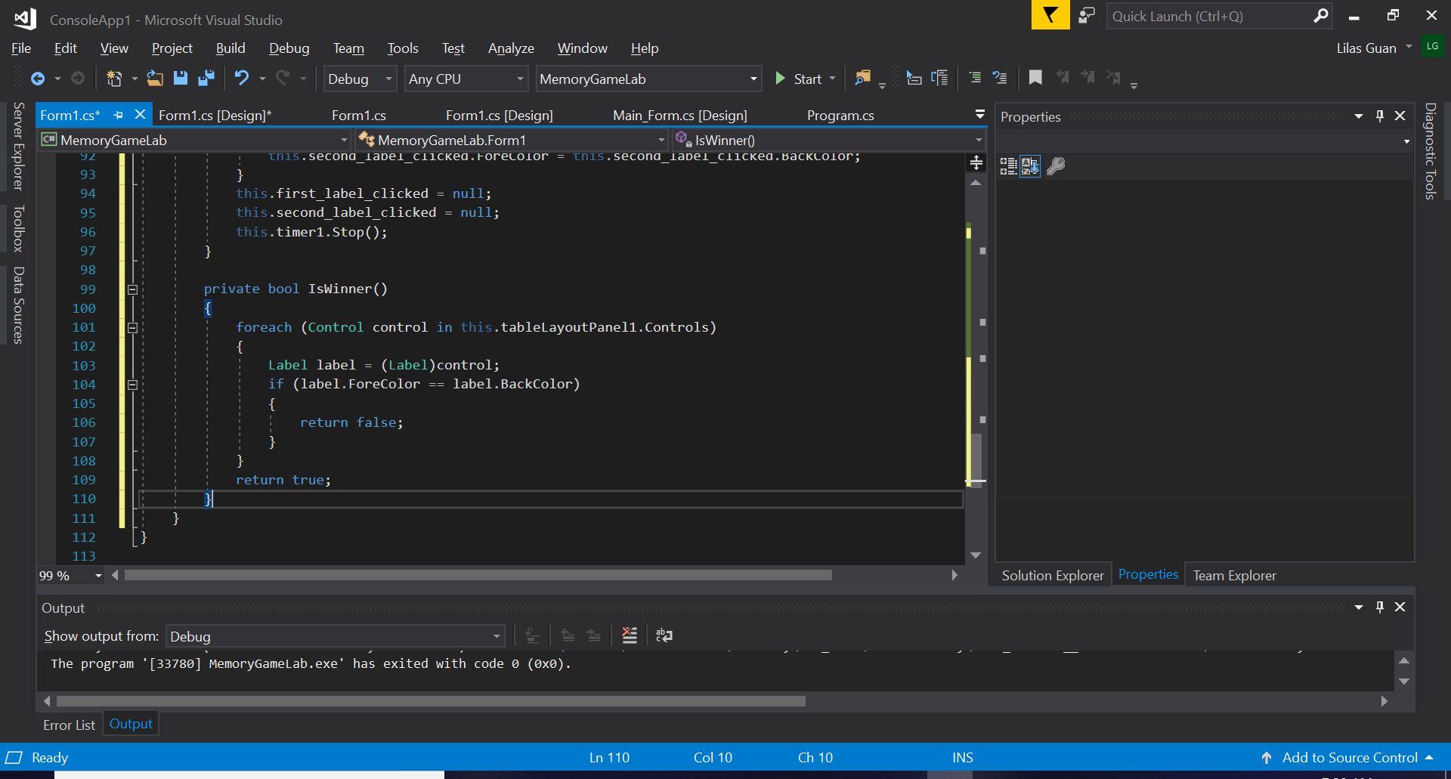
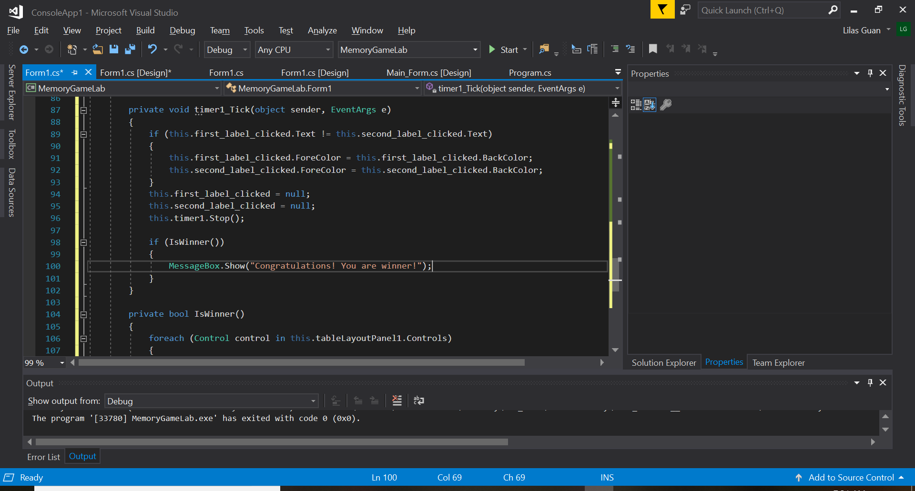
Now Serious Business, the code T-T (Continue)
8. Almost at the end @_@
We need to know when we found all the pairs. So we’ll create a function that would verify all the labels to see if their “ForeColor” is the same as “BackColor” or not. We’ll create a “foreach” loop like earlier in the beginning and create a bool.
-> private bool IsWinner()
{
foreach(Control control in this.tableLayoutPanel1.Controls)
{
Label label = (Label)control;
if(label.ForeColor == label.BackColor)
{
return false;
}
}
return true;
}
And we will call that function previously shown in the timer1 method since that’s what is verifying if the icons are the same or not. We’ll create a “MessageBox” that will tell the user when the pairs have all been found.
-> if (IsWinner())
{
MessageBox.Show("Congratulations! You are winner!");
}
All that is left is to Run the Application ;)

Slide 30
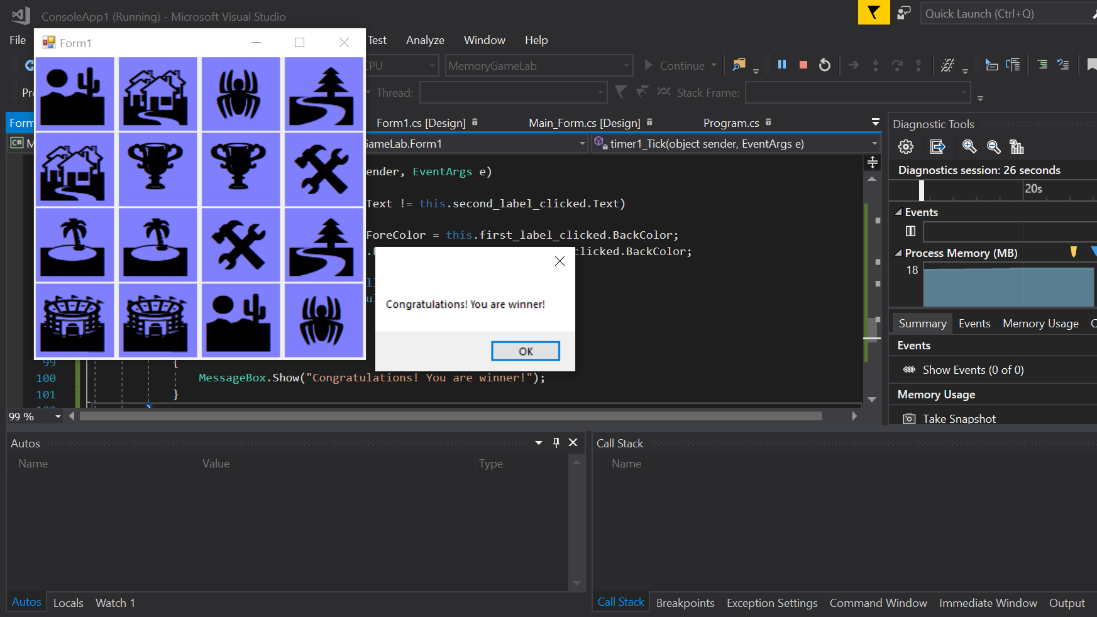
The Result should be similar to this xD Congrats we have completed the exercise :D

Slide 31
Questions?
If I can answer, I’ll be glad to help (^^;)

Slide 32
Thank you very much for your time <(_ _)>
Hope it was helpful to someone at least >n<

